Slide 1

What is LSSSE?
LSSSE is a survey that:
  Law schools use to assess the extent to which law students engage in educational practices associated with high levels of learning and development
  Is co-sponsored by the Association of American Law Schools (AALS) and The Carnegie Foundation for the Advancement of Teaching
Notes:
The Association of American Law Schools is a non-profit association of 166 law schools. The purpose of the association is "the improvement of the legal profession through legal education." It serves as the learned society for law teachers and is legal education's principal representative to the federal government and to other national higher education organizations and learned societies.
Andrew Carnegie founded The Carnegie Foundation for the Advancement of Teaching in 1905, “to do all things necessary to encourage, uphold and dignify the profession of teaching.” The Foundation is the only advanced study center for teachers in the world and the third oldest foundation in the nation.

Slide 2
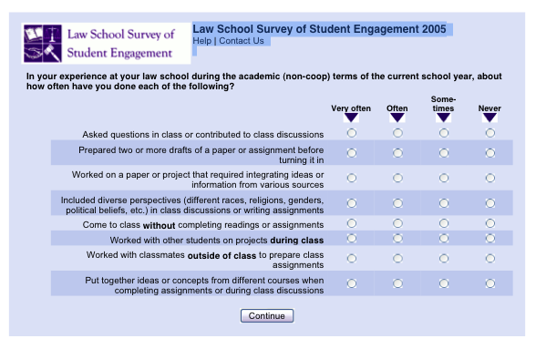
How Does LSSSE Work?
All JD students surveyed
Students fill out survey online
Multiple follow ups to increase response rates
Notes:
All JD students who have attended the law school for at least one semester/term are surveyed. Because the LSSSE survey is administered in the spring, students have at least one semester’s worth of experience upon which to reflect. This provides more reliable responses than if students were to be surveyed in the fall.
The customized e-mail invitations sent to students are electronically signed by the law school dean or another representative from your law school. This personalization reflects the law school’s interest in the results, and leads to higher response rates.

Slide 3

Why are Self-Reported
Answers Useful and Valid?
Requested information is known to respondents
Questions phrased clearly and unambiguously
Respondents take questions seriously and thoughtfully
Answering does not threaten, embarrass, violate privacy, or compel a socially desirable response
The LSSSE survey was designed to meet all of these conditions
Notes:
Does the instrument yield valid information?
Survey items are clearly worded, well-defined, and have high face and content validity. Logical relationships exist between the items in ways that are consistent with the results of objective measures and with other research.
Overall, the pattern of responses from 1L, 2L, 3L and 4L students suggest the items are measuring what they are supposed to measure.
Is the instrument stable?
Reliable measurement tools provide consistent readings from one administration to the next. In an effort to determine stability, we will examine whether students at the same law schools report their experiences in similar ways from one year to the next. Additional information will be posted on the LSSSE website in fall 2005.

Slide 4
Who Participates in LSSSE?
Year | Law Schools | Students
2003 Pilot | 11 | 4,325 respondents
2004 | 42 | 13,197 respondents
2005 | 53 | 21,653 respondents
57% response rate in 2005
53% response rate in both LSSSE 2004 & LSSSE 2003 Pilot
Public and private law schools
Full-time and part-time law students
Annual survey
Notes:
The LSSSE conducted the second national administration in spring 2005 with 53 participating law schools. All American law schools were invited to participate in the survey. A list of participating schools is included later in this presentation.
Institutional response rates ranged from 34% to 73%, with an average response rate of 57% per law school.

Slide 5
Who Responded to LSSSE at Northeastern University School of Law?
72% response (433 students)
 | Respondents | Population | %
1L | 151 | 215 | 70%
2L | 133 | 194 | 69%
3L | 149 | 194 | 77%
 | Characteristics
Men | 162 | 433 | 37%
Women | 271 | 433 | 63%
Notes:
The overall response rate for your law school is listed in your Respondent Characteristics Table in the Law School Report 2005.
Information about the number of respondents per class and by gender is available on your Law School Data File that is included electronically on your CD in SPSS (a statistical program).

Slide 6


Law School Report 2005:
Comparison Groups
Size (less than 500, 500-900, more than 900 JD students)
Affiliation (public, private, religious)
National (all LSSSE 2005 schools)
Notes:
Your law school data is compared to three normative groups:
schools with a similar number of JD students,
law schools with the same affiliation,
and all participating LSSSE 2005 law schools.
More information about interpreting these comparisons is available in the Interpreting the Means Comparison Report document included in the Law School Report 2005.

Slide 7
LSSSE 2005
Less than 500 Students Surveyed
Arkansas-Fayetteville
Arkansas-Little Rock
Brigham Young
Charleston
City University of NY at Queens
District of Columbia
Drake
Franklin Pierce
Idaho
Mercer
Nevada - Las Vegas
Ohio Northern
South Dakota
Southern Illinois
Tennessee
Washburn
Notes:
Select the slide that represents your first comparison group based on the number of JD students surveyed.

Slide 8
LSSSE 2005
500 – 900 Students Surveyed
Alabama
Case Western
Detroit Mercy
Florida Coastal
Georgia State
Indiana – Bloomington
Loyola-Chicago
Missouri-Kansas City
Northeastern
Osgoode
Pace
Pittsburgh
Quinnipiac
Saint Louis
San Francisco
Samford
Syracuse
Texas Wesleyan
Touro
Notes:
Select the slide that represents your first comparison group based on the number of JD students surveyed.

Slide 9
LSSSE 2005
More than 900 Students Surveyed
American
Baltimore
California Western
Catholic
Concord
Fordham
Georgetown
Harvard
New York Law
Pacific
Santa Clara
Seattle
Seton Hall
South Texas
Southwestern
Stetson
Suffolk
Whittier
Notes:
Select the slide that represents your first comparison group based on the number of JD students surveyed.

Slide 10
LSSSE 2005
Public Law Schools
Alabama
Arkansas-Fayetteville
Arkansas-Little Rock
Baltimore
City University of NY at Queens
District of Columbia
Georgia State
Idaho
Indiana – Bloomington
Missouri – Kansas City
Nevada - Las Vegas
Osgoode
Pittsburgh
South Dakota
Southern Illinois
Temple
Texas Tech
Tennessee
Washburn
Notes:
Select the slide that represents your second comparison group based on the affiliation of your law school.

Slide 11
LSSSE 2005
Private – Not Religiously Affiliated
American
California Western
Case Western
Charleston
Concord
Drake
Florida Coastal
Franklin Pierce
Harvard
New York Law
Northeastern
Pace
Pacific
Quinnipiac
South Texas
Southwestern
Stetson
Suffolk
Syracuse
Whittier
Notes:
Select the slide that represents your second comparison group based on the affiliation of your law school.

Slide 12
LSSSE 2005
Private – Religiously Affiliated
Brigham Young
Catholic
Detroit Mercy
Fordham
Georgetown
Loyola Chicago
Mercer
Ohio Northern
Saint Louis
Samford
San Francisco
Santa Clara
Seattle
Seton Hall
Texas Wesleyan
Touro
Notes:
Select the slide that represents your second comparison group based on the affiliation of your law school.

Slide 13
Survey Results
The slides that follow give some examples of how NUSL students responded to the survey questions.
For questions where the NUSL student responses varied significantly from the others, we have also provided the responses from the comparison law school groups (by size, affiliation, or all survey participants). Where there is no comparative chart, you can assume that NUSL students were at or close to the norm for all students surveyed.

Slide 14
What percent of NUSL students asked questions in class or contributed to class discussions?
1L
94%
2L
100%
3L
99%
Notes:
This section utilizes data from your Law School Report 2005. Using this template, you can create additional slides that address areas of interest for your audience. Insert your law school name and data from your school’s Frequency Distribution Report .

Slide 15
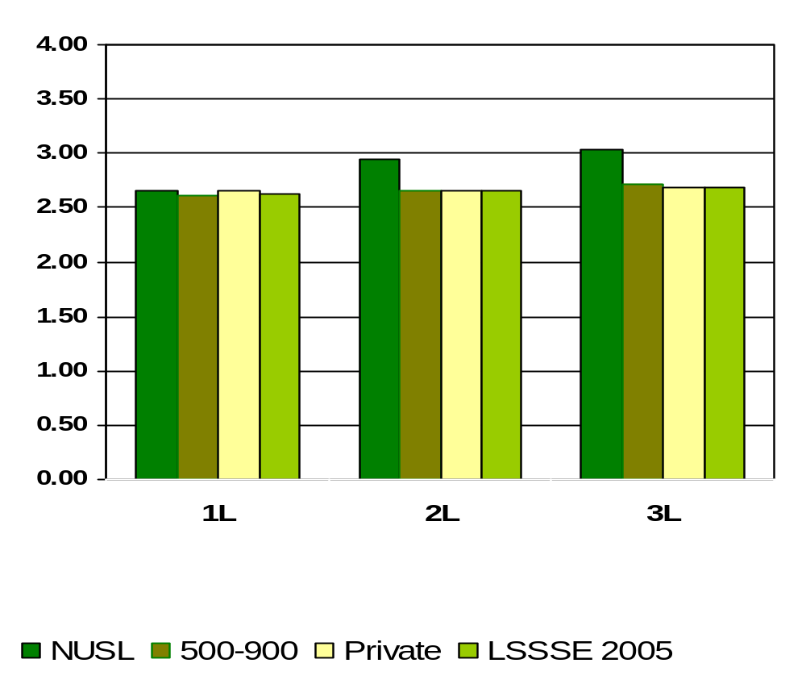
Asked Questions in Class or Contributed to a Class Discussion
Means of student responses on a scale of 1 to 4 where 1=Never and 4=Very Often
Notes:
Comparative data for these slides is available in the Means Comparisons section. Please enter for checked items only.
To modify this slide, double-click on the slide. Then, enter the appropriate data into the Excel table. Sample data is included in the chart above.

Slide 16
What percent of NUSL students prepared two or more drafts of a paper before turning it in?
1L
98%
2L
89%
3L
91%
Notes:
This section utilizes data from your Law School Report 2005. Using this template, you can create additional slides that address areas of interest for your audience. Insert your law school name and data from your school’s Frequency Distribution Report .

Slide 17
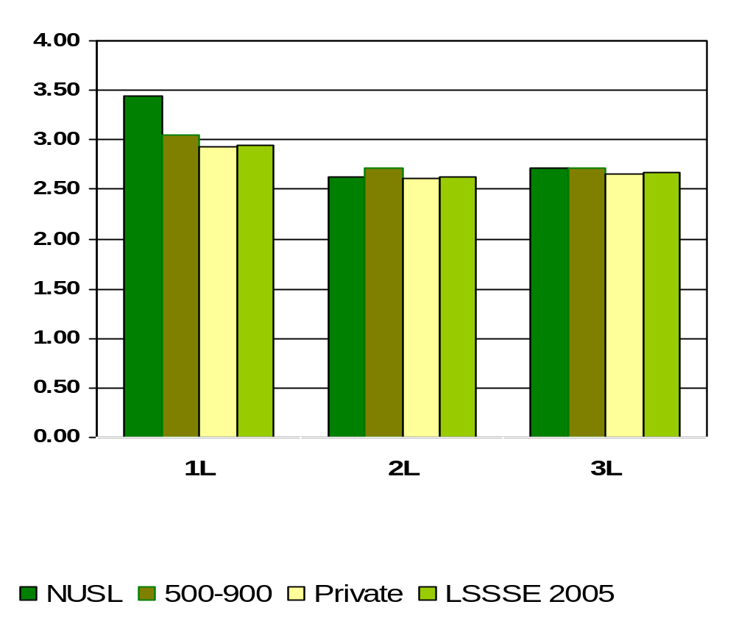
Prepared Two or More Drafts of a Paper or Assignment before turning it in
Means of student responses on a scale of 1 to 4 where 1=Never and 4=Very Often
Notes:
Comparative data for these slides is available in the Means Comparisons section. Please enter for checked items only.
To modify this slide, double-click on the slide. Then, enter the appropriate data into the Excel table. Sample data is included in the chart above.

Slide 18
What percent of NUSL students worked on a paper or project that required integrating ideas or information from various sources ?
1L
100%
2L
97%
3L
98%
Notes:
This section utilizes data from your Law School Report 2005. Using this template, you can create additional slides that address areas of interest for your audience. Insert your law school name and data from your school’s Frequency Distribution Report .

Slide 19
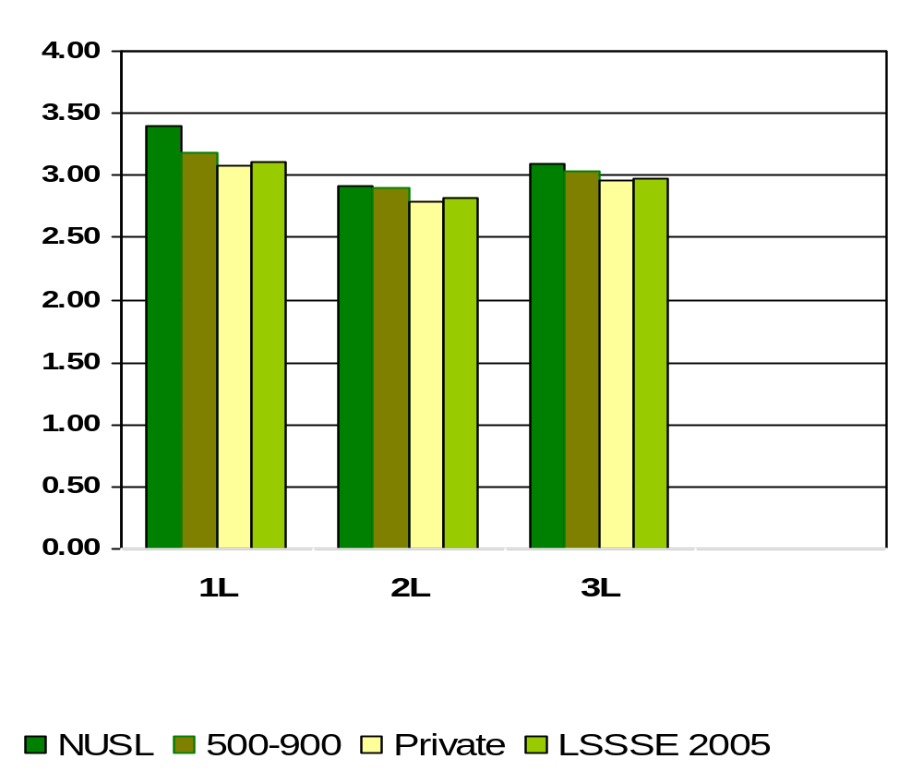
Worked on a Paper or Project that Required Integrating Ideas or Information from Various Sources
Means of student responses on a scale of 1 to 4 where 1=Never and 4=Very Often
Notes:
Comparative data for these slides is available in the Means Comparisons section. Please enter for checked items only.
To modify this slide, double-click on the slide. Then, enter the appropriate data into the Excel table. Sample data is included in the chart above.

Slide 20
What percent of NUSL students included diverse perspectives (different races, religions, genders, political beliefs, etc.) in class discussions or writing assignments ?
1L
97%
2L
97%
3L
97%
Notes:
This section utilizes data from your Law School Report 2005. Using this template, you can create additional slides that address areas of interest for your audience. Insert your law school name and data from your school’s Frequency Distribution Report .

Slide 21
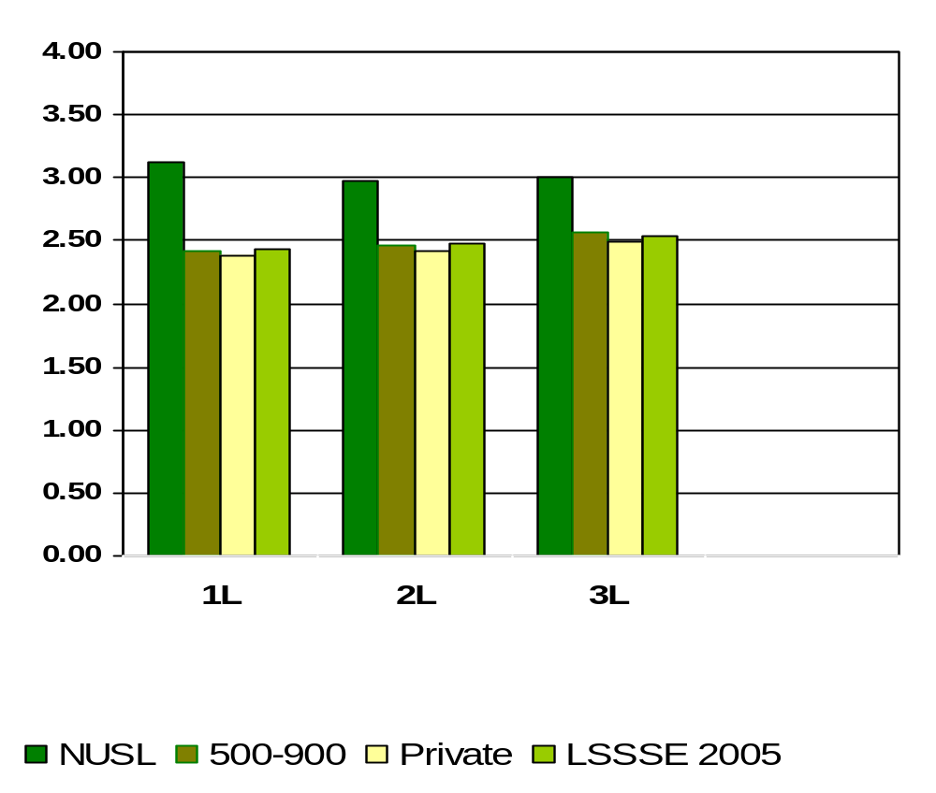
Included Diverse Perspective (different races, religions, genders, political beliefs, etc). In Class Discussions or Writing Assignments
Means of student responses on a scale of 1 to 4 where 1=Never and 4=Very Often
Notes:
Comparative data for these slides is available in the Means Comparisons section. Please enter for checked items only.
To modify this slide, double-click on the slide. Then, enter the appropriate data into the Excel table. Sample data is included in the chart above.

Slide 22
What percent of NUSL students worked with other students on projects DURING CLASS?
1L
83%
2L
84%
3L
87%
Notes:
This section utilizes data from your Law School Report 2005. Using this template, you can create additional slides that address areas of interest for your audience. Insert your law school name and data from your school’s Frequency Distribution Report .

Slide 23
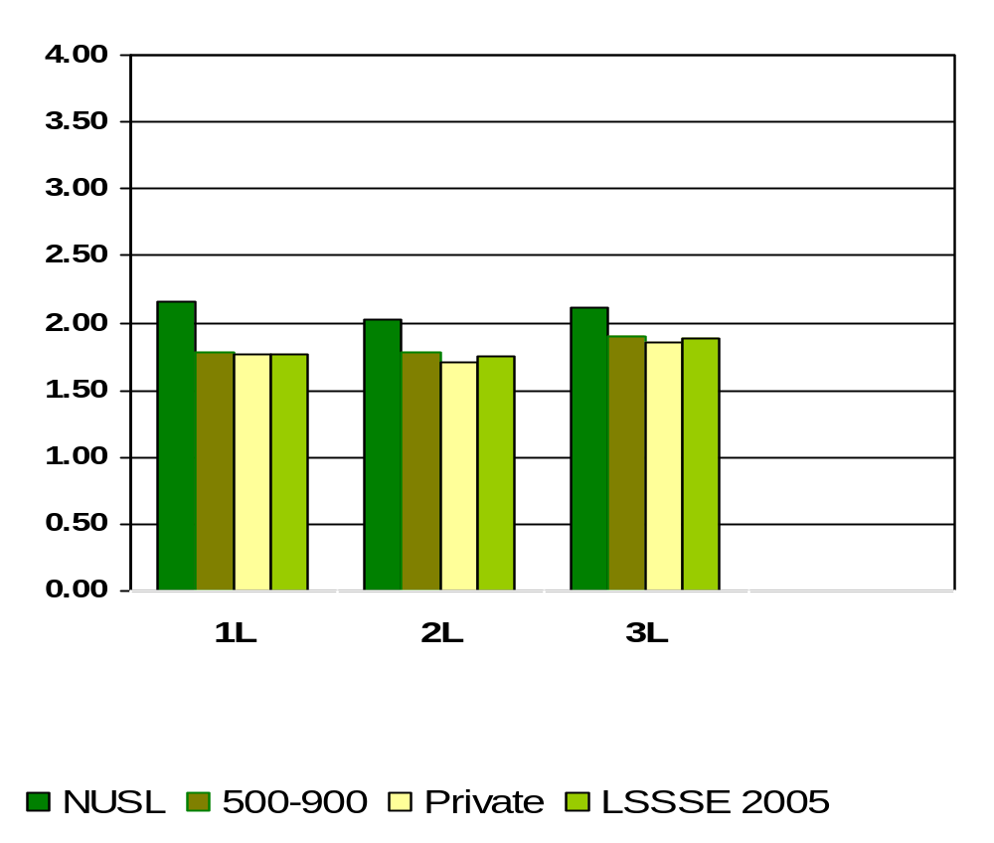
Worked with Other Students on Project During Class
Means of student responses on a scale of 1 to 4 where 1=Never and 4=Very Often
Notes:
Comparative data for these slides is available in the Means Comparisons section. Please enter for checked items only.
To modify this slide, double-click on the slide. Then, enter the appropriate data into the Excel table. Sample data is included in the chart above.

Slide 24
What percent of NUSL students worked with classmates OUTSIDE OF CLASS to prepare class assignments?
1L
98%
2L
96%
3L
98%
Notes:
This section utilizes data from your Law School Report 2005. Using this template, you can create additional slides that address areas of interest for your audience. Insert your law school name and data from your school’s Frequency Distribution Report .

Slide 25
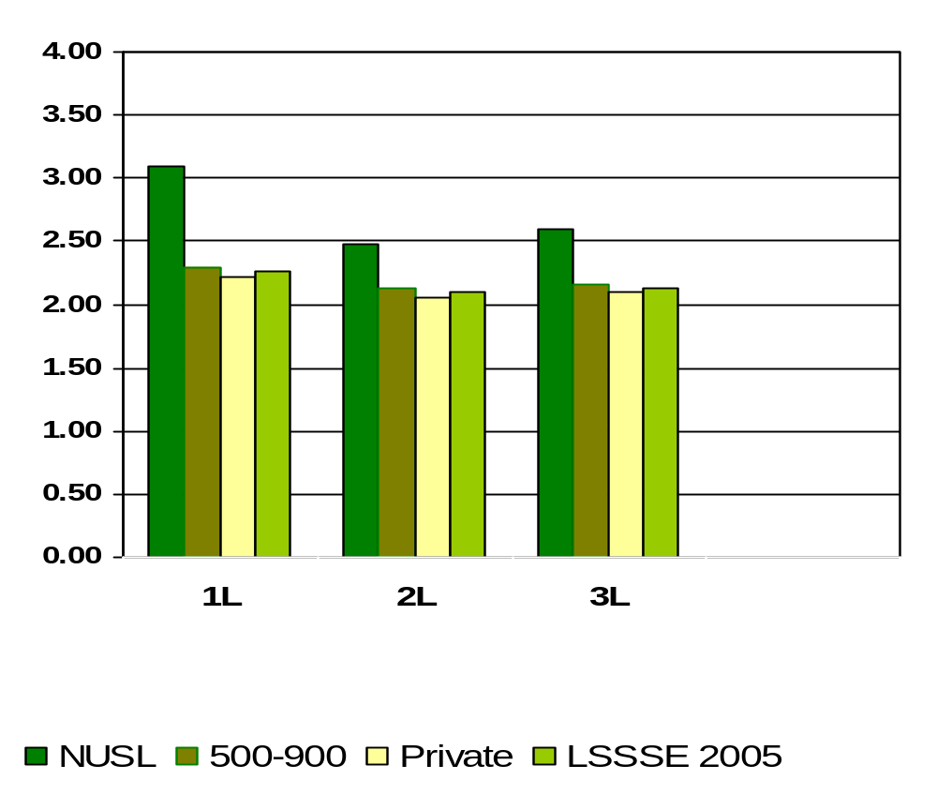
Worked with Classmates Outside of Class to Prepare Class Assignments
Means of student responses on a scale of 1 to 4 where 1=Never and 4=Very Often
Notes:
Comparative data for these slides is available in the Means Comparisons section. Please enter for checked items only.
To modify this slide, double-click on the slide. Then, enter the appropriate data into the Excel table. Sample data is included in the chart above.

Slide 26
What percent of NUSL students put together ideas or concepts from different courses when completing assignments or during class discussions ?
1L
99%
2L
95%
3L
99%
Notes:
This section utilizes data from your Law School Report 2005. Using this template, you can create additional slides that address areas of interest for your audience. Insert your law school name and data from your school’s Frequency Distribution Report .

Slide 27
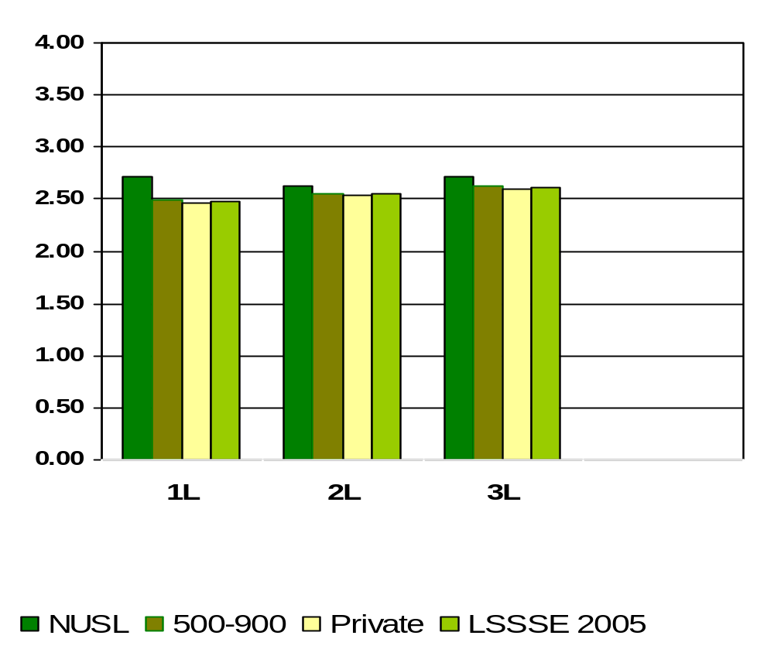
Put Together Ideas or Concepts from Different Courses when Completing Assignments or During Class Discussion
Means of student responses on a scale of 1 to 4 where 1=Never and 4=Very Often
Notes:
Comparative data for these slides is available in the Means Comparisons section. Please enter for checked items only.
To modify this slide, double-click on the slide. Then, enter the appropriate data into the Excel table. Sample data is included in the chart above.

Slide 28
What percent of NUSL students participated in a clinical or pro bono project as part of a course or for academic credit?
1L
51%
2L
57%
3L
77%
Notes:
This section utilizes data from your Law School Report 2005. Using this template, you can create additional slides that address areas of interest for your audience. Insert your law school name and data from your school’s Frequency Distribution Report .

Slide 29
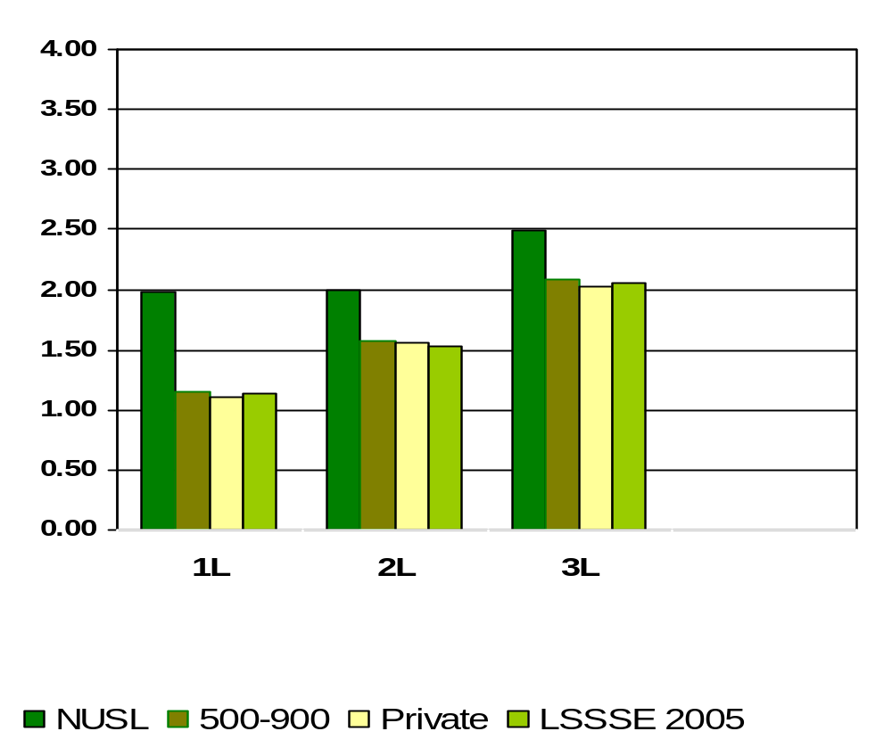
Participated in a Clinical or Pro Bono Project as Part of a Course or for Academic Credit
Means of student responses on a scale of 1 to 4 where 1=Never and 4=Very Often
Notes:
Comparative data for these slides is available in the Means Comparisons section. Please enter for checked items only.
To modify this slide, double-click on the slide. Then, enter the appropriate data into the Excel table. Sample data is included in the chart above.

Slide 30
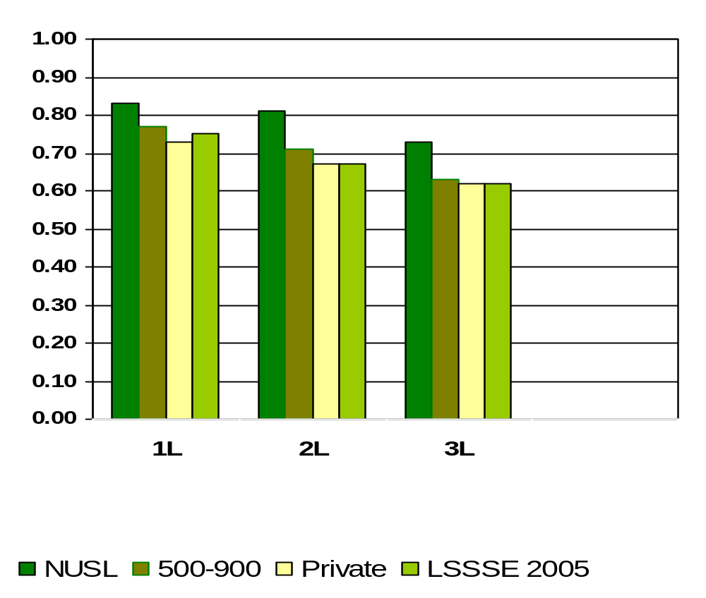
Volunteer or Pro Bono Work
Means of student responses on a scale of 0 to 1 where 0=Undecided or do not plan to do and 1=Done or plan to do
Notes:
Comparative data for these slides is available in the Means Comparisons section. Please enter for checked items only.
To modify this slide, double-click on the slide. Then, enter the appropriate data into the Excel table. Sample data is included in the chart above.

Slide 31
What percent of NUSL students used an electronic medium (listserv, chat group, Internet, instant messaging, etc.) to discuss or complete an assignment?
1L
92%
2L
84%
3L
83%
Notes:
This section utilizes data from your Law School Report 2005. Using this template, you can create additional slides that address areas of interest for your audience. Insert your law school name and data from your school’s Frequency Distribution Report .

Slide 32
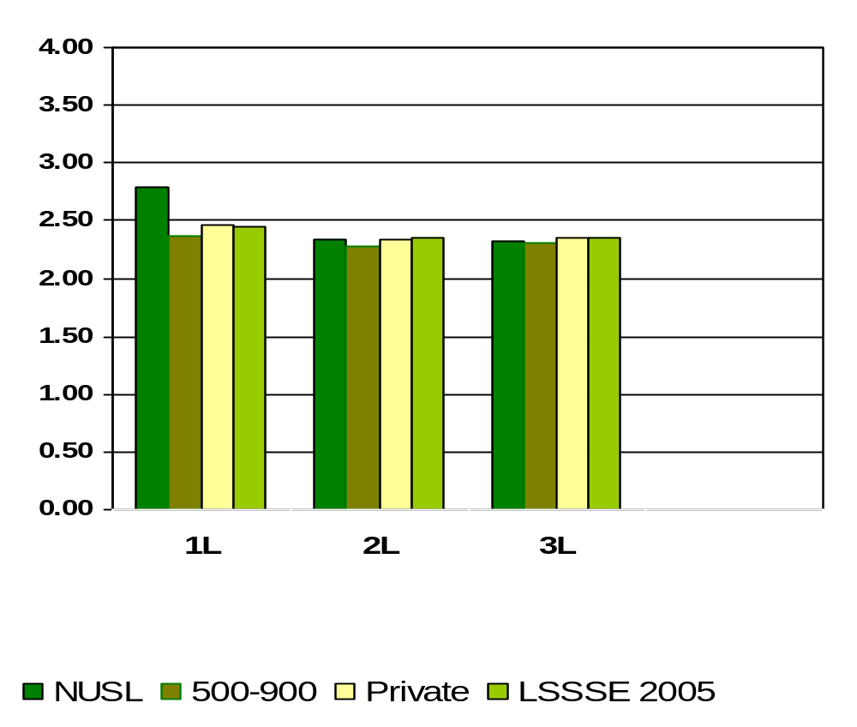
Used an Electronic Medium (listserv, chat group, Internet, instant messaging, etc.) to Discuss or Complete an Assignment
Means of student responses on a scale of 1 to 4 where 1=Never and 4=Very Often
Notes:
Comparative data for these slides is available in the Means Comparisons section. Please enter for checked items only.
To modify this slide, double-click on the slide. Then, enter the appropriate data into the Excel table. Sample data is included in the chart above.

Slide 33
What percent of NUSL students had serious conversations with students of a different race or ethnicity than their own?
1L
98%
2L
95%
3L
95%
Notes:
This section utilizes data from your Law School Report 2005. Using this template, you can create additional slides that address areas of interest for your audience. Insert your law school name and data from your school’s Frequency Distribution Report .

Slide 34
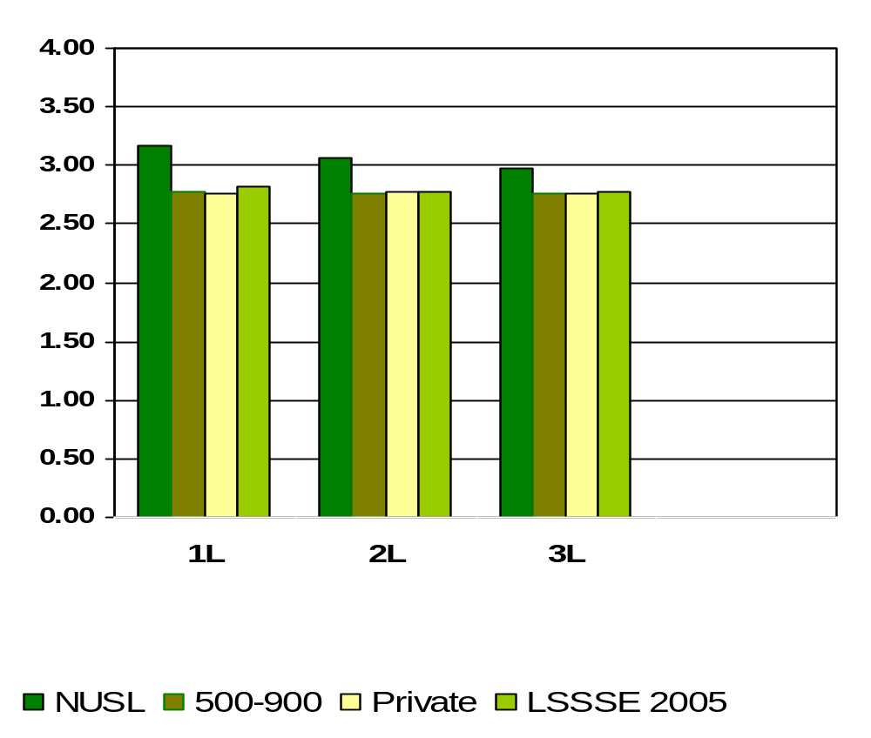
Had Serious Conversations with Students of a Different Race or Ethnicity than Your Own
Means of student responses on a scale of 1 to 4 where 1=Never and 4=Very Often
Notes:
Comparative data for these slides is available in the Means Comparisons section. Please enter for checked items only.
To modify this slide, double-click on the slide. Then, enter the appropriate data into the Excel table. Sample data is included in the chart above.

Slide 35
What percent of NUSL students felt the law school environment encourages contact among students from different economic, social, and racial or ethnic backgrounds?
1L
93%
2L
95%
3L
93%
Percentages measure students who believe “Some”, “Quite a bit” or “Very much” versus “Very Little”
Notes:
This section utilizes data from your Law School Report 2005. Using this template, you can create additional slides that address areas of interest for your audience. Insert your law school name and data from your school’s Frequency Distribution Report .

Slide 36
What percentage of NUSL students believe the law school contributed to understanding people of other racial and ethnic backgrounds?
1L
51%
2L
48%
3L
51%
Percentages measure students who believe “Quite a bit” or “Very much” versus “Some” or “Very Little”
Notes:
This section utilizes data from your Law School Report 2005. Using this template, you can create additional slides that address areas of interest for your audience. Insert your law school name and data from your school’s Frequency Distribution Report .

Slide 37
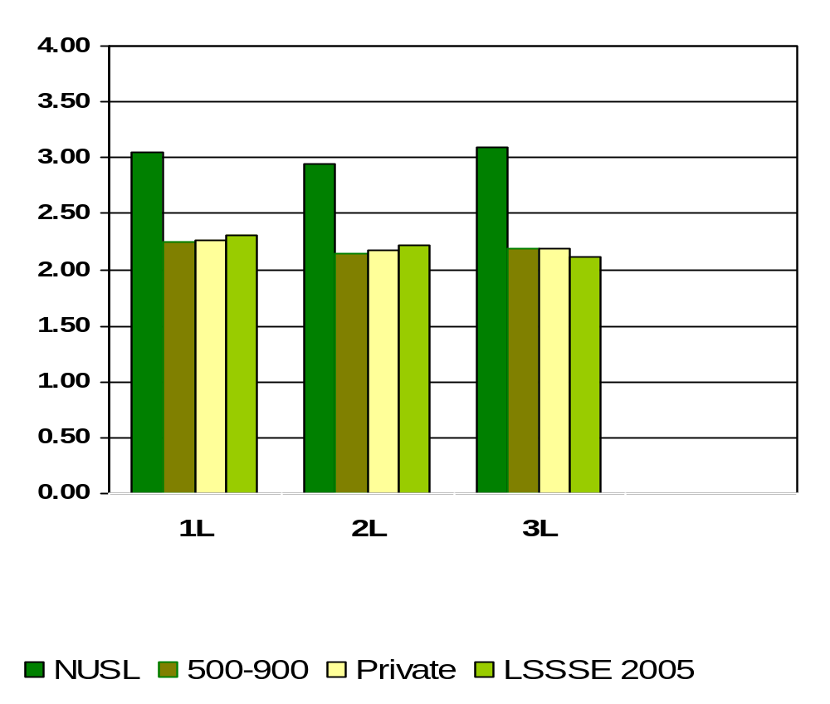
How Much Does Law School Emphasize Encouraging Contact Among Students from Different Economical, Social and Racial or Ethnic Backgrounds
Means of student responses on a scale of 1 to 4 where 1=Very Little and 4=Very Much
Notes:
Comparative data for these slides is available in the Means Comparisons section. Please enter for checked items only.
To modify this slide, double-click on the slide. Then, enter the appropriate data into the Excel table. Sample data is included in the chart above.

Slide 38
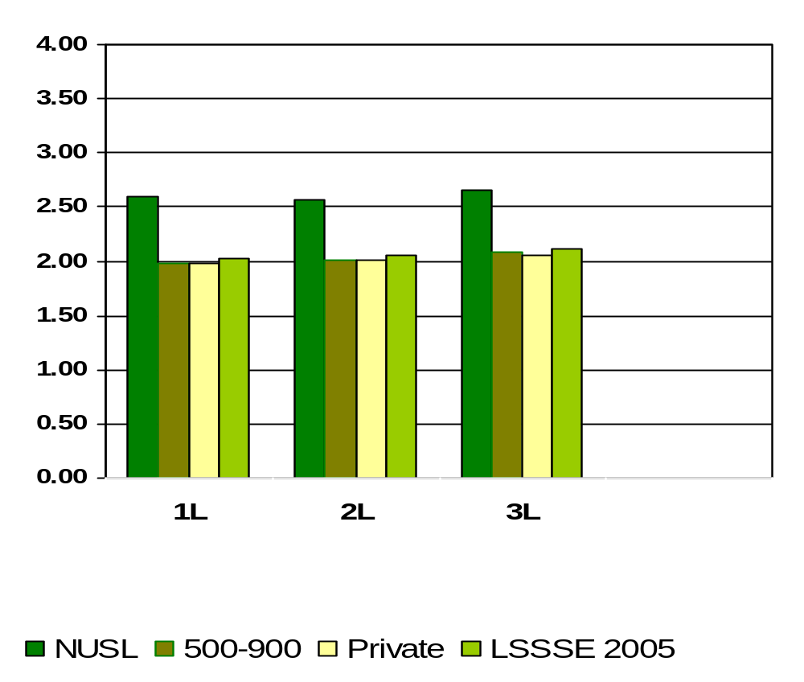
How Much Law School Experience Contributed to Understanding People of Other Racial and Ethnic Backgrounds
Means of student responses on a scale of 1 to 4 where 1=Very Little and 4=Very Much
Notes:
Comparative data for these slides is available in the Means Comparisons section. Please enter for checked items only.
To modify this slide, double-click on the slide. Then, enter the appropriate data into the Excel table. Sample data is included in the chart above.

Slide 39
What percent of NUSL students felt coursework emphasized memorizing facts, ideas or methods quite a bit or very much of the time
1L
31%
2L
39%
3L
33%
Notes:
This section utilizes data from your Law School Report 2005. Using this template, you can create additional slides that address areas of interest for your audience. Insert your law school name and data from your school’s Frequency Distribution Report .

Slide 40
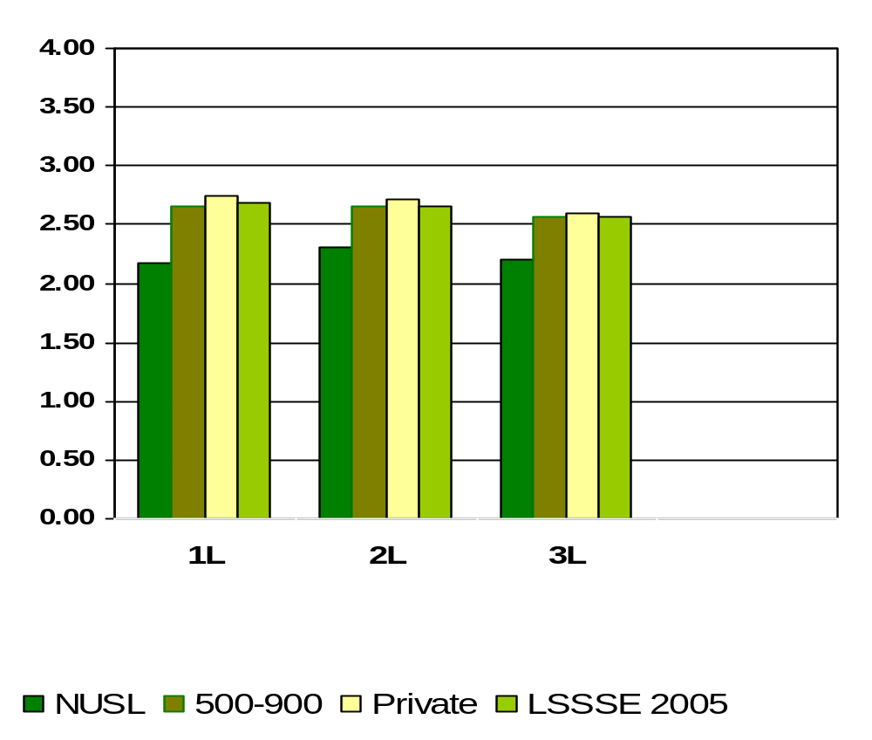
Memorizing Facts, Ideas, or Methods from Your Courses and Readings so You Can Repeat Them Pretty Much in the Same Form
Means of student responses on a scale of 1 to 4 where 1=Very Little and 4=Very Much
Notes:
Comparative data for these slides is available in the Means Comparisons section. Please enter for checked items only.
To modify this slide, double-click on the slide. Then, enter the appropriate data into the Excel table. Sample data is included in the chart above.

Slide 41
During the current school year, what percent of NUSL students had written at least one paper of FEWER THAN 5 PAGES?
1L
82%
2L
87%
3L
92%
Notes:
This section utilizes data from your Law School Report 2005. Using this template, you can create additional slides that address areas of interest for your audience. Insert your law school name and data from your school’s Frequency Distribution Report .

Slide 42
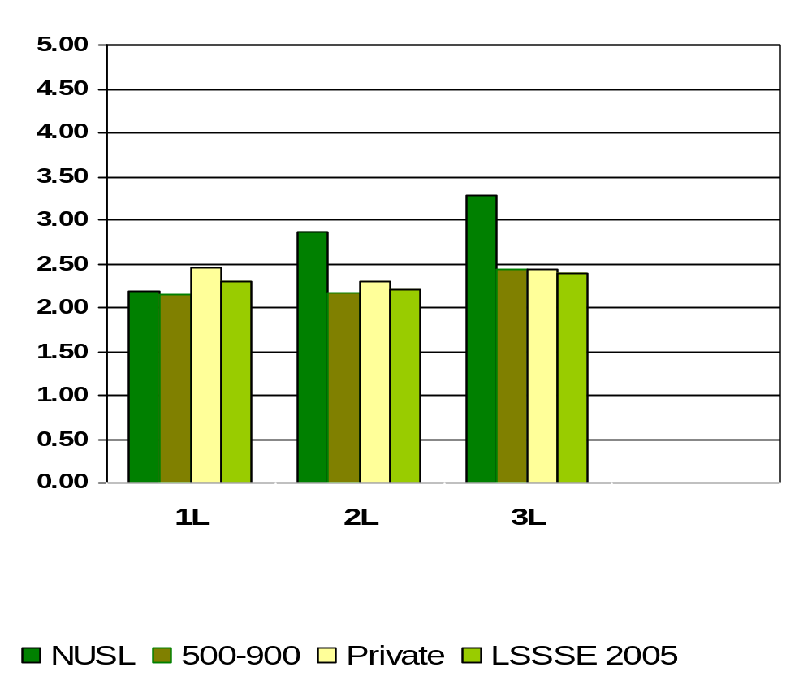
Number of Written Pages of Fewer than 5 pages
Means of student responses on a scale of 1 to 5 where 1=0 papers, 2=1-3 papers, 3=4-6 papers, 4=7-9 papers, 5=10 or more papers.
Notes:
Comparative data for these slides is available in the Means Comparisons section. Please enter for checked items only.
To modify this slide, double-click on the slide. Then, enter the appropriate data into the Excel table. Sample data is included in the chart above.

Slide 43
During the current school year, what percent of NUSL students had written at least one paper of BETWEEN 5 AND 19 PAGES?
1L
99%
2L
90%
3L
92%
Notes:
This section utilizes data from your Law School Report 2005. Using this template, you can create additional slides that address areas of interest for your audience. Insert your law school name and data from your school’s Frequency Distribution Report .

Slide 44
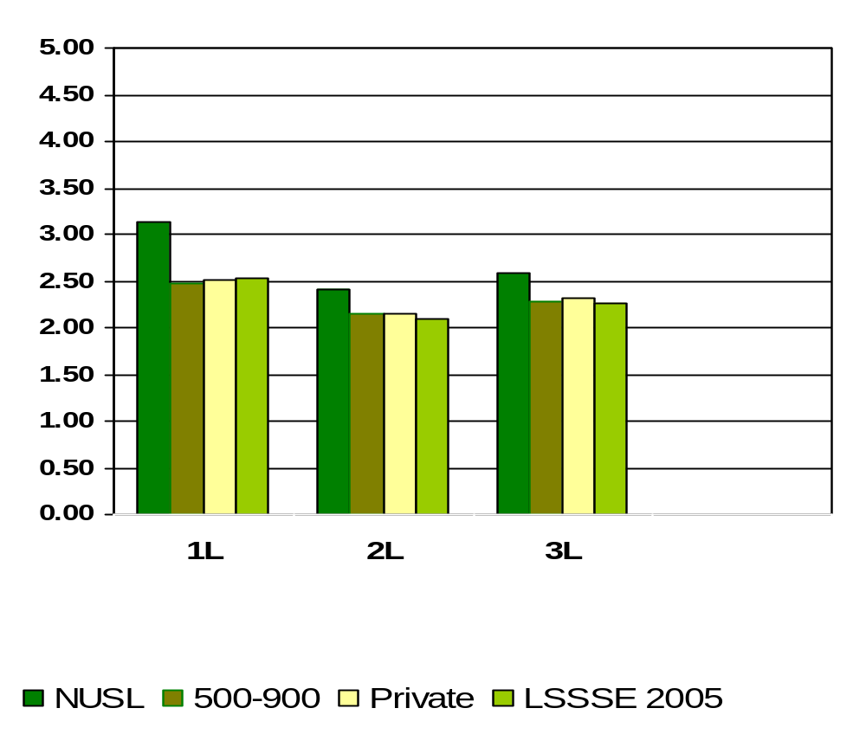
Number of Written Papers between 5 and 19 Pages
Means of student responses on a scale of 1 to 5 where 1=0 papers, 2=1-3 papers, 3=4-6 papers, 4=7-9 papers, 5=10 or more papers.
Notes:
Comparative data for these slides is available in the Means Comparisons section. Please enter for checked items only.
To modify this slide, double-click on the slide. Then, enter the appropriate data into the Excel table. Sample data is included in the chart above.

Slide 45
During the current school year, what percent of NUSL students had written at least one paper of 20 PAGES OR MORE?
1L
78%
2L
70%
3L
81%
Notes:
This section utilizes data from your Law School Report 2005. Using this template, you can create additional slides that address areas of interest for your audience. Insert your law school name and data from your school’s Frequency Distribution Report .

Slide 46
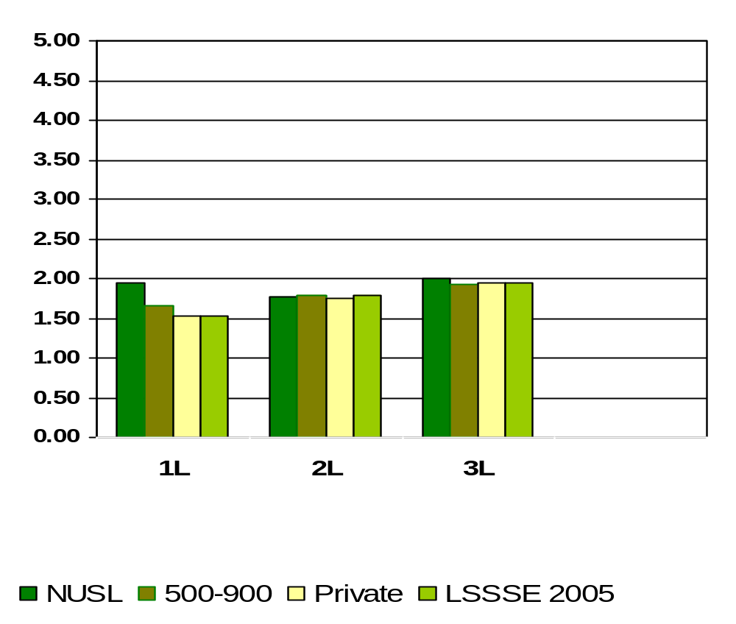
Number of Written Papers of 20 Pages or More
Means of student responses on a scale of 1 to 5 where 1=0 papers, 2=1-3 papers, 3=4-6 papers, 4=7-9 papers, 5=10 or more papers.
Notes:
Comparative data for these slides is available in the Means Comparisons section. Please enter for checked items only.
To modify this slide, double-click on the slide. Then, enter the appropriate data into the Excel table. Sample data is included in the chart above.

Slide 47
Hours per Week Spent
Reading Assigned Class Materials
What percentage of NUSL students spent more than 20 hours per week reading assigned textbooks, online class reading, and other course materials?
1L
52%
2L
30%
3L
26%
Notes:
This section utilizes data from your Law School Report 2005. Using this template, you can create additional slides that address areas of interest for your audience. Insert your law school name and data from your school’s Frequency Distribution Report.

Slide 48
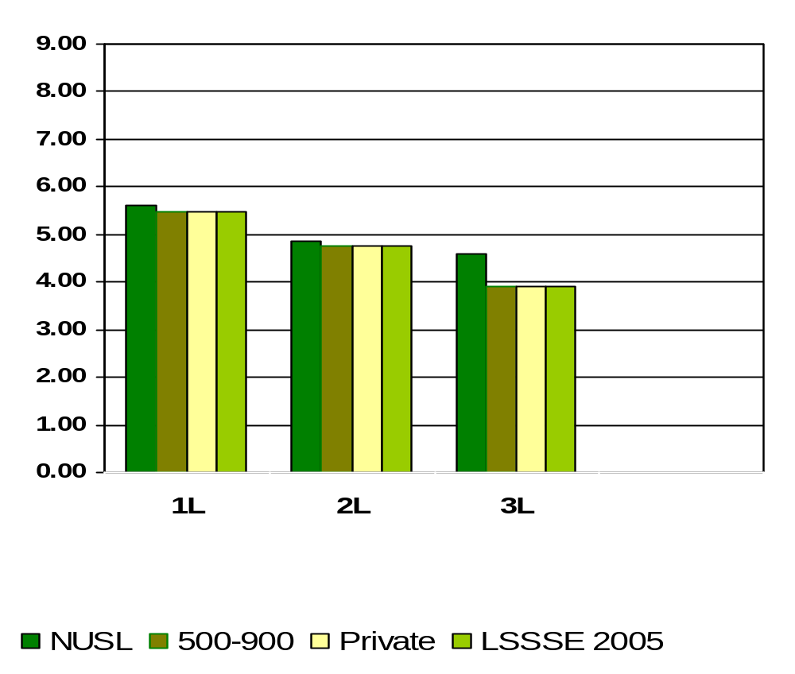
Reading Assigned Textbooks, Online Class Reading, and Other Course Materials
Means of student responses on a scale of 1 to 9 where 1=0hrs/wk and 9= More than 35 hours per week
Notes:
Comparative data for these slides is available in the Means Comparisons section. Please enter for checked items only.
To modify this slide, double-click on the slide. Then, enter the appropriate data into the Excel table. Sample data is included in the chart above.

Slide 49
Hours per Week Spent
Preparing for Class and Clinical Courses OTHER THAN READING?
What percentage of NUSL students spent more than 10 hours per week preparing for class and clinical courses OTHER THAN READING?
1L
20%
2L
20%
3L
27%
Notes:
This section utilizes data from your Law School Report 2005. Using this template, you can create additional slides that address areas of interest for your audience. Insert your law school name and data from your school’s Frequency Distribution Report.

Slide 50
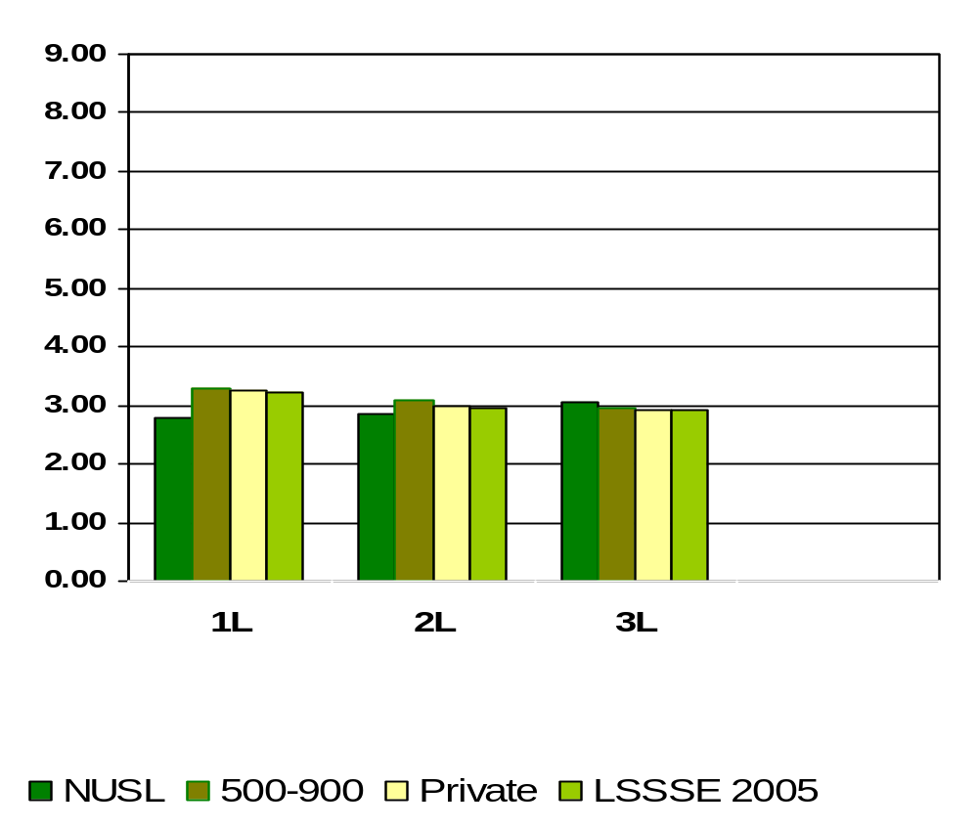
Preparing for Class and Clinical Courses Other than Reading (studying, writing, doing homework, trial preparation, and other academic activities)
Means of student responses on a scale of 1 to 9 where 1=0hrs/wk and 9=More than 35 hours per week
Notes:
Comparative data for these slides is available in the Means Comparisons section. Please enter for checked items only.
To modify this slide, double-click on the slide. Then, enter the appropriate data into the Excel table. Sample data is included in the chart above.

Slide 51
Worked for Pay in
Law-Related or Nonlegal Job
What percentage of NUSL students worked for pay in either law-related or nonlegal jobs?
1L
55%
2L
55%
3L
71%
Notes:
This section utilizes data from your Law School Report 2005. Using this template, you can create additional slides that address areas of interest for your audience. Insert your law school name and data from your school’s Frequency Distribution Report.

Slide 52
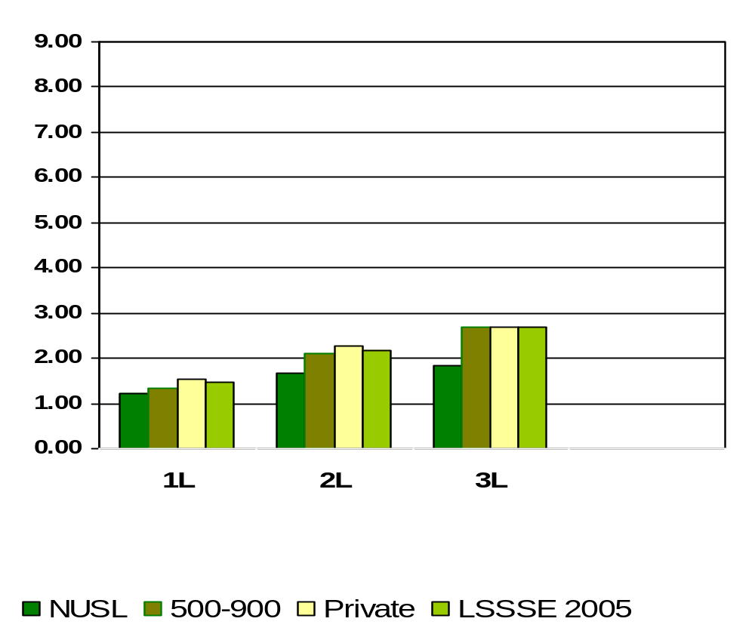
Working for Pay in Law-Related Job
Means of student responses on a scale of 1 to 9 where 1=0hrs/wk and 9=More than 35 hours per week
Notes:
Comparative data for these slides is available in the Means Comparisons section. Please enter for checked items only.
To modify this slide, double-click on the slide. Then, enter the appropriate data into the Excel table. Sample data is included in the chart above.

Slide 53
What percent of NUSL students come to class often or very often WITHOUT completing readings or assignments ?
1L
8%
2L
20%
3L
17%
Notes:
This section utilizes data from your Law School Report 2005. Using this template, you can create additional slides that address areas of interest for your audience. Insert your law school name and data from your school’s Frequency Distribution Report .

Slide 54
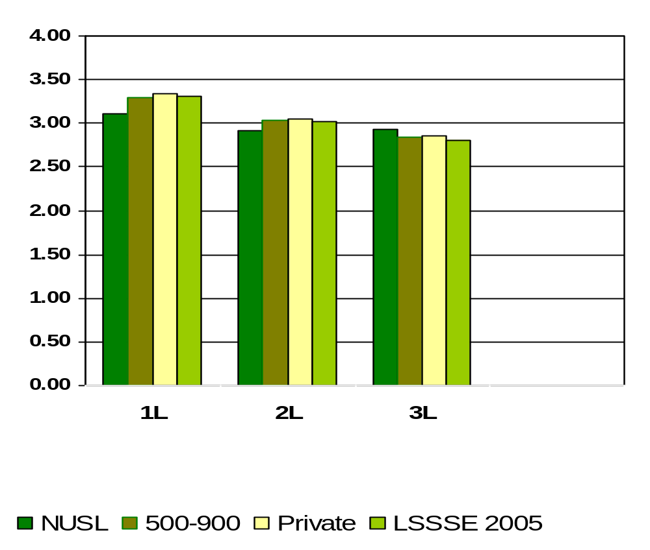
Come to Class without completing readings or assignments (Note: Item has been reverse coded so that 4=Never, 3=Sometimes, 2=Often, 1=Very Often)
Notes:
Comparative data for these slides is available in the Means Comparisons section. Please enter for checked items only.
To modify this slide, double-click on the slide. Then, enter the appropriate data into the Excel table. Sample data is included in the chart above.

Slide 55
What percent of NUSL students had discussed assignments with a faculty member?
1L
89%
2L
97%
3L
97%
Notes:
This section utilizes data from your Law School Report 2005. Using this template, you can create additional slides that address areas of interest for your audience. Insert your law school name and data from your school’s Frequency Distribution Report .

Slide 56
What percent of NUSL students discussed ideas from readings or classes with faculty members outside of class?
1L
72%
2L
73%
3L
80%
Notes:
This section utilizes data from your Law School Report 2005. Using this template, you can create additional slides that address areas of interest for your audience. Insert your law school name and data from your school’s Frequency Distribution Report .

Slide 57
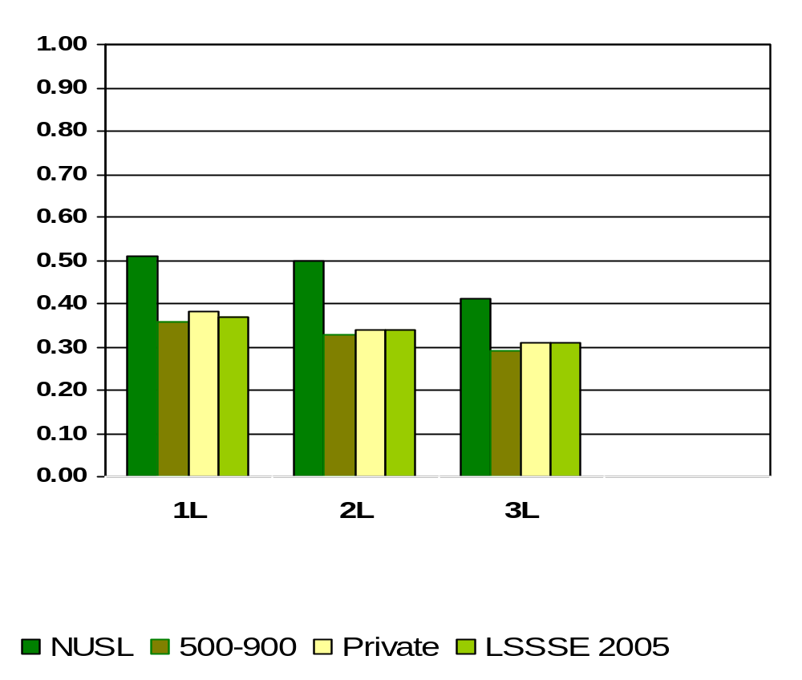
Worked on a Legal Research Project with a Faculty Member Outside of Course or Program Requirements
Means of student responses on a scale of 0 to 1 where 0=Undecided or do not plan to do and 1=Done or plan to do
Notes:
Comparative data for these slides is available in the Means Comparisons section. Please enter for checked items only.
To modify this slide, double-click on the slide. Then, enter the appropriate data into the Excel table. Sample data is included in the chart above.

Slide 58
What percent of NUSL students analyzed the basic elements of an idea, experience, or theory, such as examining a particular case or situation in depth?
1L
95%
2L
90%
3L
95%
Percentages measure students who complete above tasks either “Quite a bit” or “Very much” versus “Very Little” or “Some”
Notes:
This section utilizes data from your Law School Report 2005. Using this template, you can create additional slides that address areas of interest for your audience. Insert your law school name and data from your school’s Frequency Distribution Report .

Slide 59
What percent of NUSL students synthesized and organized ideas, information, or experiences into new, more complex interpretations and relationships?
1L
91%
2L
80%
3L
78%
Percentages measure students who complete above tasks either “Quite a bit” or “Very much” versus “Very Little” or “Some”
Notes:
This section utilizes data from your Law School Report 2005. Using this template, you can create additional slides that address areas of interest for your audience. Insert your law school name and data from your school’s Frequency Distribution Report .

Slide 60
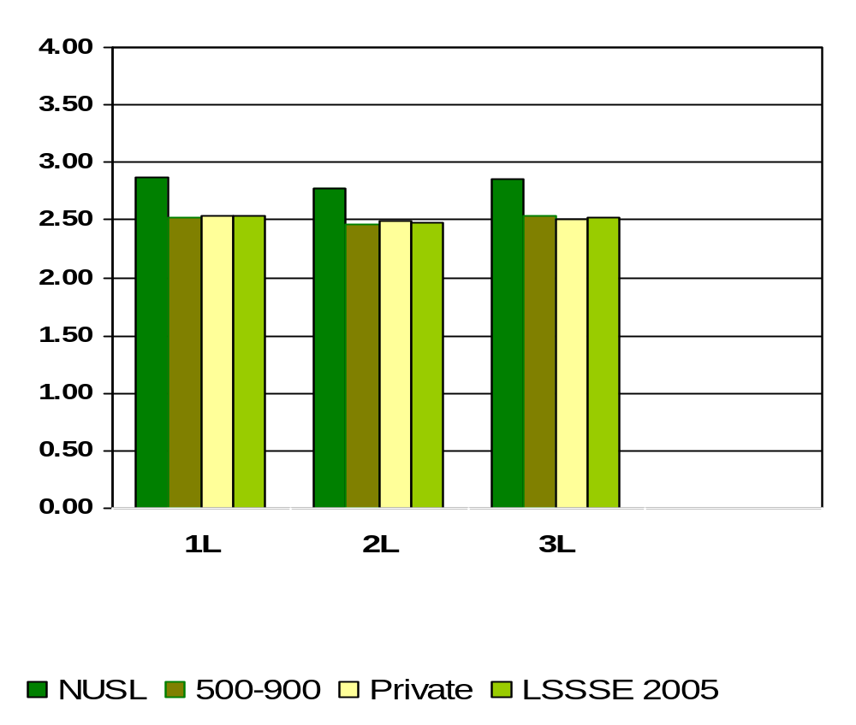
How Much Law School Experience Contributed to Solving Complex and Real-World Problems
Means of student responses on a scale of 1 to 4 where 1=Very Little and 4=Very Much
Notes:
Comparative data for these slides is available in the Means Comparisons section. Please enter for checked items only.
To modify this slide, double-click on the slide. Then, enter the appropriate data into the Excel table. Sample data is included in the chart above.

Slide 61
What percent of NUSL students made judgments about the value of information, arguments, or methods, such as examining how others gathered and interpreted data and assessing the soundness of their conclusions?
1L
79%
2L
70%
3L
74%
Percentages measure students who complete above tasks either “Quite a bit” or “Very much” versus “Very Little” or “Some”
Notes:
This section utilizes data from your Law School Report 2005. Using this template, you can create additional slides that address areas of interest for your audience. Insert your law school name and data from your school’s Frequency Distribution Report .

Slide 62
What percent of NUSL students applied theories or concepts to practical problems or in new situations?
1L
90%
2L
84%
3L
85%
Percentages measure students who complete above tasks either “Quite a bit” or “Very much” versus “Very Little” or “Some”
Notes:
This section utilizes data from your Law School Report 2005. Using this template, you can create additional slides that address areas of interest for your audience. Insert your law school name and data from your school’s Frequency Distribution Report .

Slide 63
What percent of NUSL students felt satisfaction with academic advising and planning?
1L
56%
2L
45%
3L
52%
Percentages measure students who are either “Satisfied” or “Very satisfied” versus “Not Used”, “Very unsatisfied” or “Unsatisfied”
Notes:
This section utilizes data from your Law School Report 2005. Using this template, you can create additional slides that address areas of interest for your audience. Insert your law school name and data from your school’s Frequency Distribution Report .

Slide 64
What percent of NUSL students felt satisfaction with career counseling?
1L
62%
2L
57%
3L
53%
Percentages measure students who are either “Satisfied” or “Very satisfied” versus “Not Used”, “Very unsatisfied” or “Unsatisfied”
Notes:
This section utilizes data from your Law School Report 2005. Using this template, you can create additional slides that address areas of interest for your audience. Insert your law school name and data from your school’s Frequency Distribution Report .

Slide 65
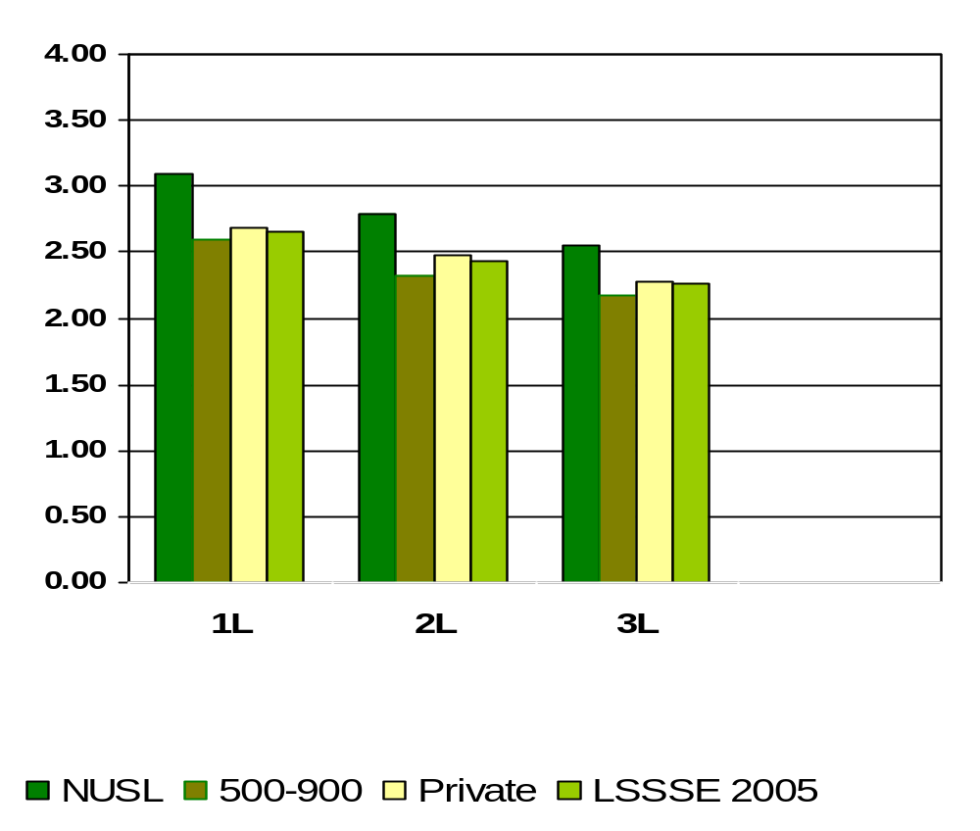
Satisfaction with Career Counseling
Means of student responses on a scale of 1 to 4 where 1=Very Unsatisfied and 4=Very Satisfied
Notes:
Comparative data for these slides is available in the Means Comparisons section. Please enter for checked items only.
To modify this slide, double-click on the slide. Then, enter the appropriate data into the Excel table. Sample data is included in the chart above.

Slide 66
What percent of NUSL students talked about career plans or job search activities with a faculty member or advisor?
1L
70%
2L
75%
3L
86%
Notes:
This section utilizes data from your Law School Report 2005. Using this template, you can create additional slides that address areas of interest for your audience. Insert your law school name and data from your school’s Frequency Distribution Report .

Slide 67
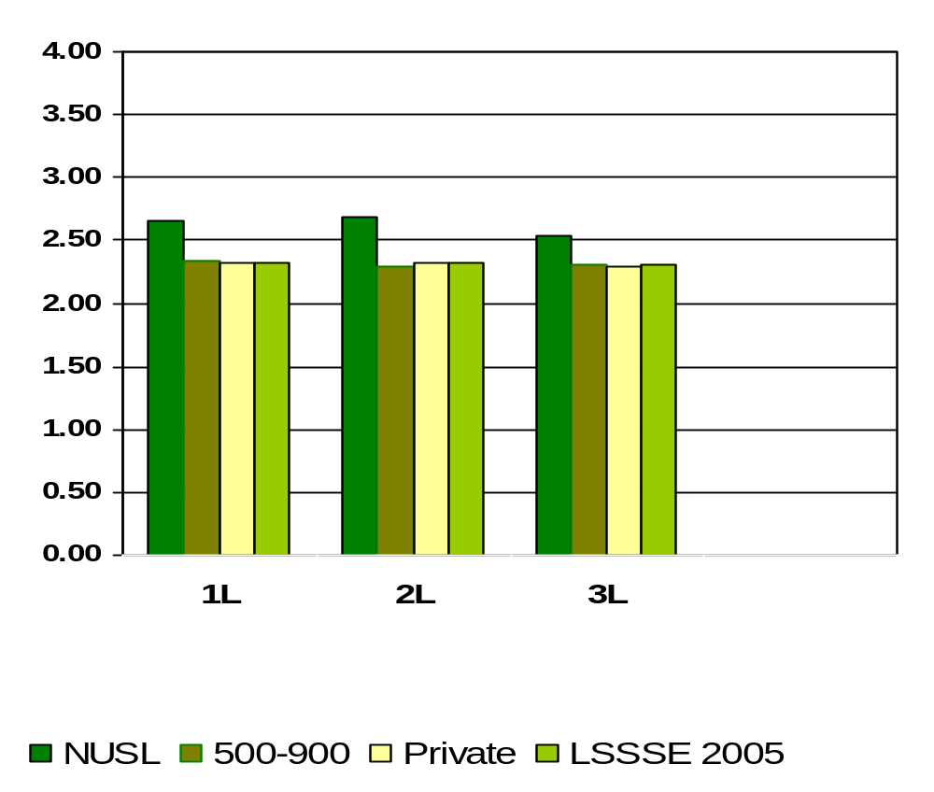
How Much Law School Experience Contributed to Developing Clearer Career Goals
Means of student responses on a scale of 1 to 4 where 1=Very Little and 4=Very Much
Notes:
Comparative data for these slides is available in the Means Comparisons section. Please enter for checked items only.
To modify this slide, double-click on the slide. Then, enter the appropriate data into the Excel table. Sample data is included in the chart above.

Slide 68
What percent of NUSL students felt satisfaction with job search help?
1L
53%
2L
48%
3L
40%
Percentages measure students who are either “Satisfied” or “Very satisfied” versus “Not Used”, “Very unsatisfied” or “Unsatisfied”
Notes:
This section utilizes data from your Law School Report 2005. Using this template, you can create additional slides that address areas of interest for your audience. Insert your law school name and data from your school’s Frequency Distribution Report .

Slide 69
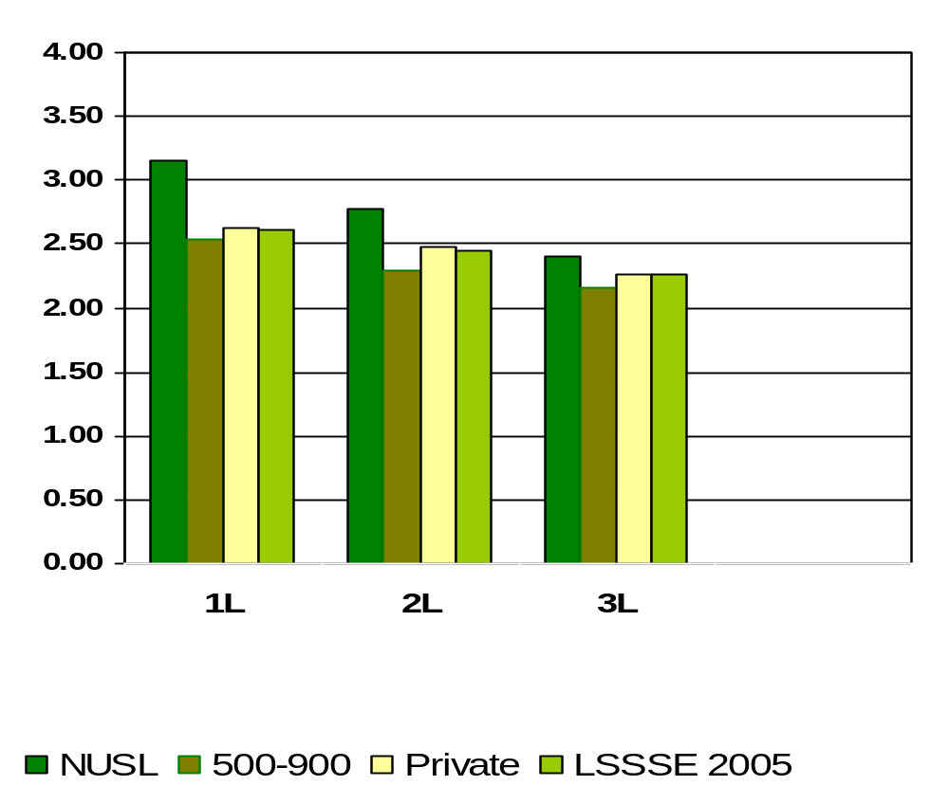
Satisfaction with Job Search Help
Means of student responses on a scale of 1 to 4 where 1=Very Unsatisfied and 4=Very Satisfied
Notes:
Comparative data for these slides is available in the Means Comparisons section. Please enter for checked items only.
To modify this slide, double-click on the slide. Then, enter the appropriate data into the Excel table. Sample data is included in the chart above.

Slide 70
What percent of NUSL students felt satisfaction with personal counseling?
1L
29%
2L
30%
3L
31%
Percentages measure students who are either “Satisfied” or “Very satisfied” versus “Not Used”, “Very unsatisfied” or “Unsatisfied”
Notes:
This section utilizes data from your Law School Report 2005. Using this template, you can create additional slides that address areas of interest for your audience. Insert your law school name and data from your school’s Frequency Distribution Report .

Slide 71
What percent of NUSL students felt satisfaction with financial aid advising?
1L
60%
2L
61%
3L
68%
Percentages measure students who are either “Satisfied” or “Very satisfied” versus “Not Used”, “Very unsatisfied” or “Unsatisfied”
Notes:
This section utilizes data from your Law School Report 2005. Using this template, you can create additional slides that address areas of interest for your audience. Insert your law school name and data from your school’s Frequency Distribution Report .

Slide 72
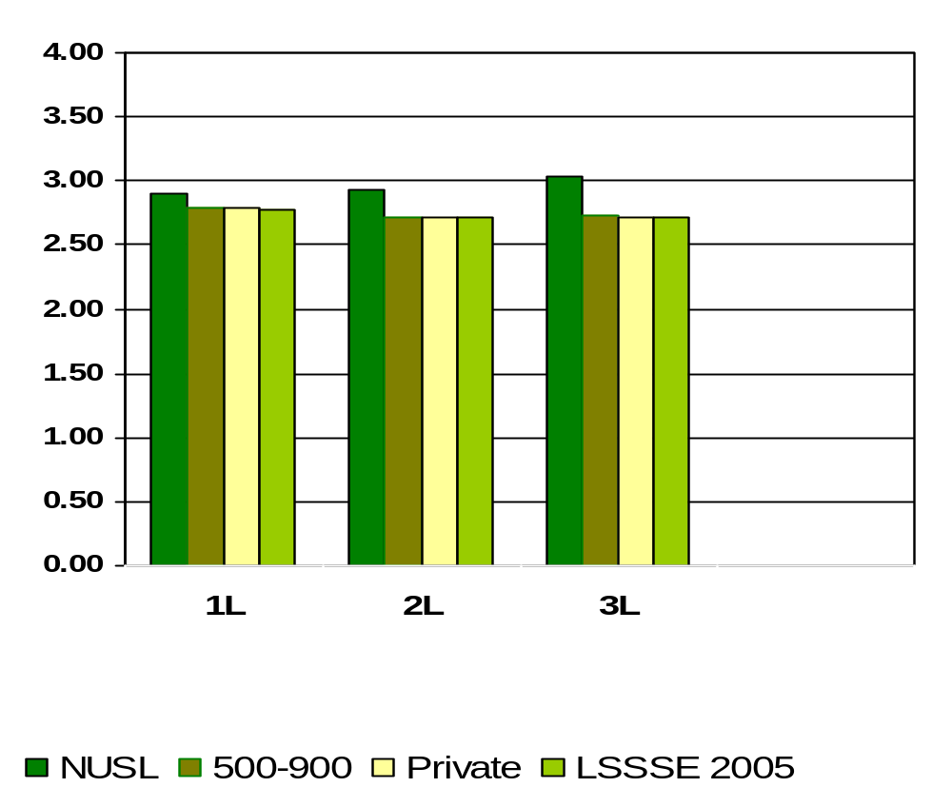
Satisfaction with Financial Aid Advising
Means of student responses on a scale of 1 to 4 where 1=Very Unsatisfied and 4=Very Satisfied
Notes:
Comparative data for these slides is available in the Means Comparisons section. Please enter for checked items only.
To modify this slide, double-click on the slide. Then, enter the appropriate data into the Excel table. Sample data is included in the chart above.

Slide 73
What percent of NUSL students felt satisfaction with library assistance?
1L
91%
2L
90%
3L
90%
Percentages measure students who are either “Satisfied” or “Very satisfied” versus “Not Used”, “Very unsatisfied” or “Unsatisfied”
Notes:
This section utilizes data from your Law School Report 2005. Using this template, you can create additional slides that address areas of interest for your audience. Insert your law school name and data from your school’s Frequency Distribution Report .

Slide 74
What percentage of NUSL students believe the law school contributed to developing their use of computing and information technology?
1L
41%
2L
33%
3L
40%
Percentages measure students who believe “Quite a bit” or “Very much” versus “Some” or “Very Little”
Notes:
This section utilizes data from your Law School Report 2005. Using this template, you can create additional slides that address areas of interest for your audience. Insert your law school name and data from your school’s Frequency Distribution Report .

Slide 75
What percent of NUSL students felt satisfaction with computing technology?
1L
71%
2L
68%
3L
69%
Percentages measure students who are either “Satisfied” or “Very satisfied” versus “Not Used”, “Very unsatisfied” or “Unsatisfied”
Notes:
This section utilizes data from your Law School Report 2005. Using this template, you can create additional slides that address areas of interest for your audience. Insert your law school name and data from your school’s Frequency Distribution Report .

Slide 76
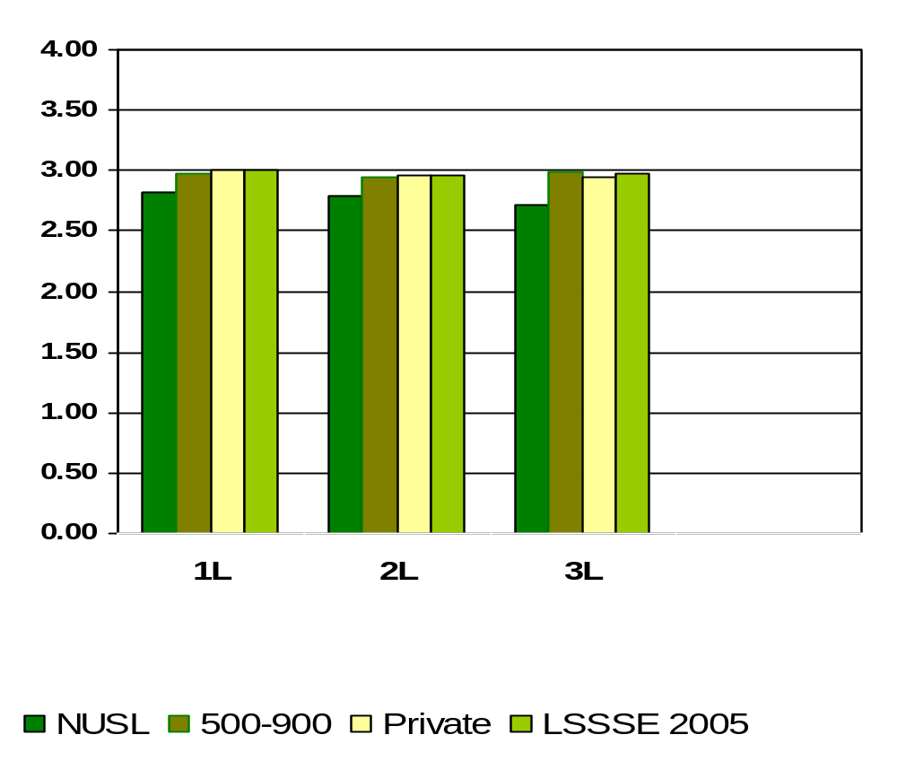
Satisfaction with Computing Technology
Means of student responses on a scale of 1 to 4 where 1=Very Unsatisfied and 4=Very Satisfied
Notes:
Comparative data for these slides is available in the Means Comparisons section. Please enter for checked items only.
To modify this slide, double-click on the slide. Then, enter the appropriate data into the Excel table. Sample data is included in the chart above.

Slide 77
What percent of NUSL students spend significant amounts of time studying and on academic work?
1L
99%
2L
99%
3L
97%
Percentages measure students who are either spend “Some”, “Quite a bit” or “Very much” amounts of time versus “Very Little” amounts of time
Notes:
This section utilizes data from your Law School Report 2005. Using this template, you can create additional slides that address areas of interest for your audience. Insert your law school name and data from your school’s Frequency Distribution Report .

Slide 78
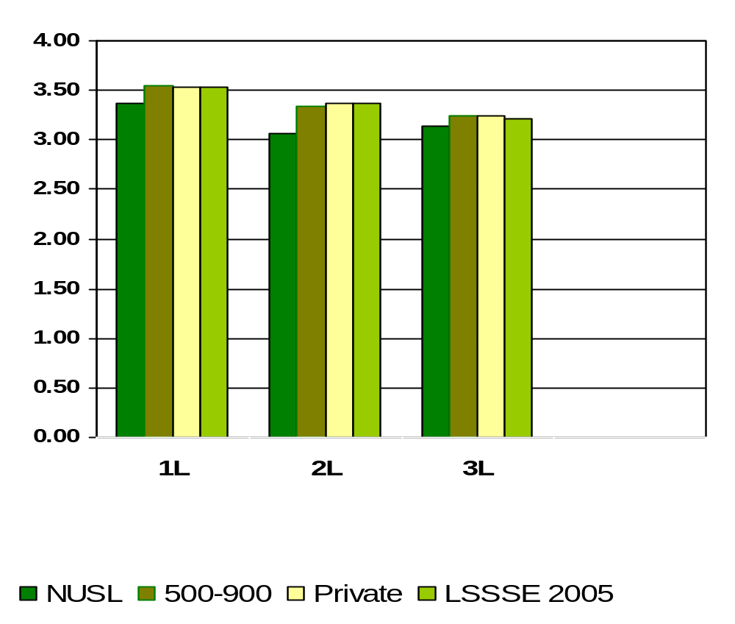
How Much Does Law School Emphasize Spending Significant Amounts of Time Studying and on Academic Work
Means of student responses on a scale of 1 to 4 where 1=Very Little and 4=Very Much
Notes:
Comparative data for these slides is available in the Means Comparisons section. Please enter for checked items only.
To modify this slide, double-click on the slide. Then, enter the appropriate data into the Excel table. Sample data is included in the chart above.

Slide 79
What percent of NUSL students felt the law school environment encourages the ethical practice of the law?
1L
99%
2L
99%
3L
99%
Percentages measure students who believe “Some”, “Quite a bit” or “Very much” versus “Very Little”
Notes:
This section utilizes data from your Law School Report 2005. Using this template, you can create additional slides that address areas of interest for your audience. Insert your law school name and data from your school’s Frequency Distribution Report .

Slide 80
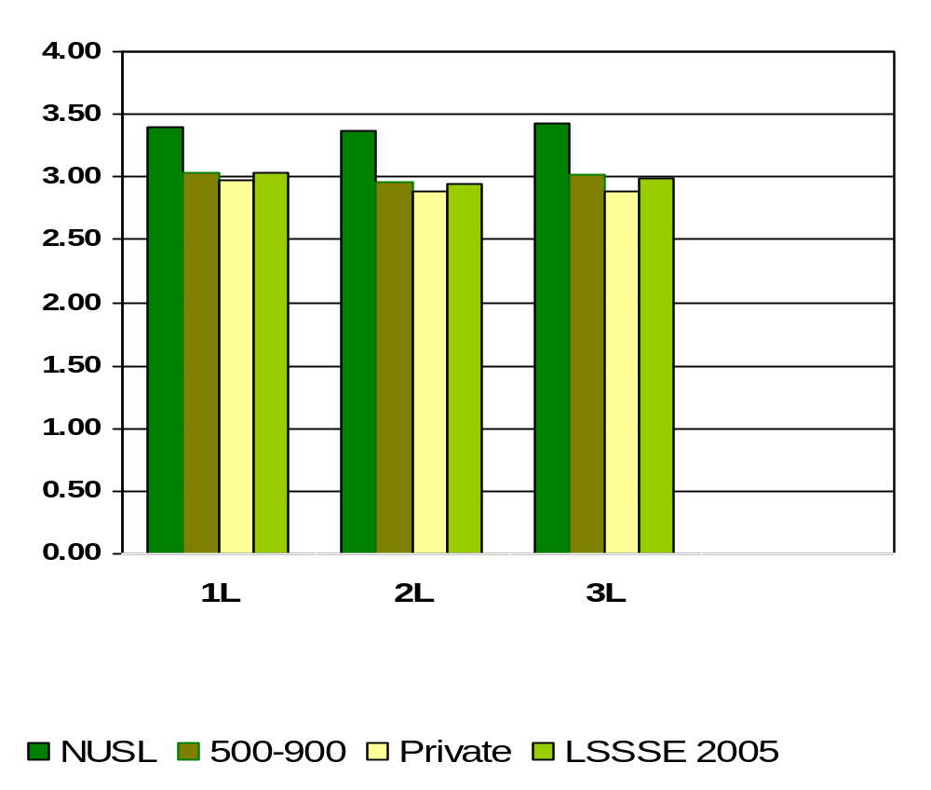
How Much Does Law School Emphasize Encouraging the Ethical Practice of Law
Means of student responses on a scale of 1 to 4 where 1=Very Little and 4=Very Much
Notes:
Comparative data for these slides is available in the Means Comparisons section. Please enter for checked items only.
To modify this slide, double-click on the slide. Then, enter the appropriate data into the Excel table. Sample data is included in the chart above.

Slide 81
What percent of NUSL students felt the law school environment provides the support they need to help succeed academically?
1L
96%
2L
93%
3L
93%
Percentages measure students who believe “Some”, “Quite a bit” or “Very much” versus “Very Little”
Notes:
This section utilizes data from your Law School Report 2005. Using this template, you can create additional slides that address areas of interest for your audience. Insert your law school name and data from your school’s Frequency Distribution Report .

Slide 82
What percent of NUSL students felt the law school environment provides the support they need in their employment search?
1L
96%
2L
93%
3L
93%
Percentages measure students who believe “Some”, “Quite a bit” or “Very much” versus “Very Little”
Notes:
This section utilizes data from your Law School Report 2005. Using this template, you can create additional slides that address areas of interest for your audience. Insert your law school name and data from your school’s Frequency Distribution Report .

Slide 83
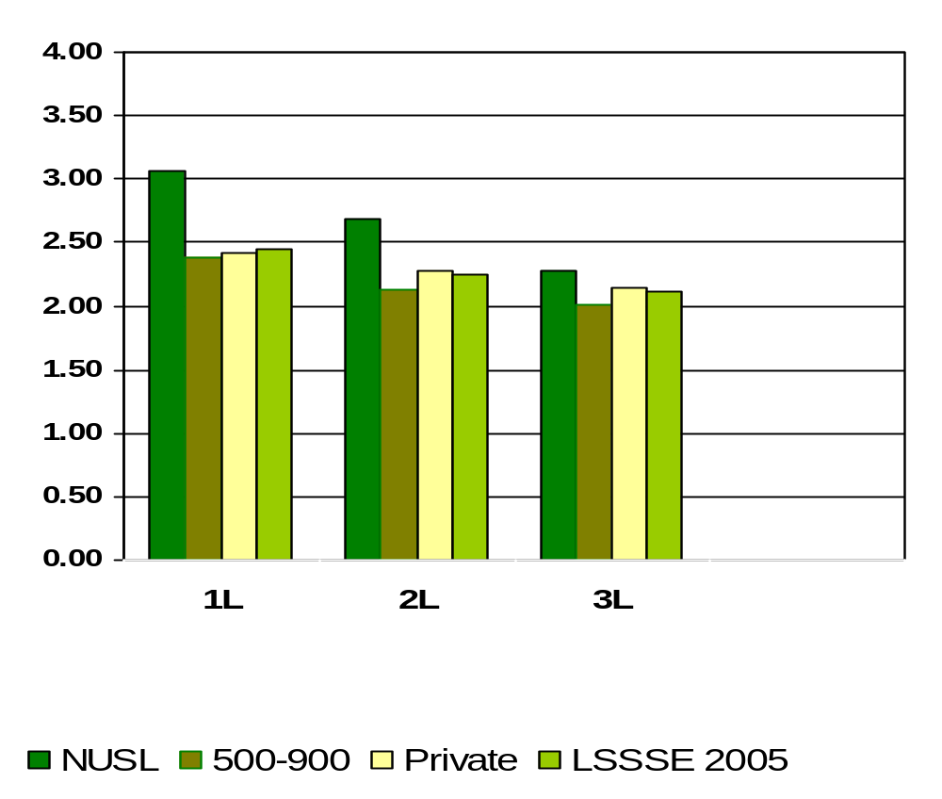
How Much Does Law School Emphasize Providing the Support You Need to Succeed in Your Employment Search
Means of student responses on a scale of 1 to 4 where 1=Very Little and 4=Very Much
Notes:
Comparative data for these slides is available in the Means Comparisons section. Please enter for checked items only.
To modify this slide, double-click on the slide. Then, enter the appropriate data into the Excel table. Sample data is included in the chart above.

Slide 84
What percent of NUSL students felt the law school environment helps them cope with their non-academic responsibilities (work, family, etc.)?
1L
66%
2L
64%
3L
54%
Percentages measure students who believe “Some”, “Quite a bit” or “Very much” versus “Very Little”
Notes:
This section utilizes data from your Law School Report 2005. Using this template, you can create additional slides that address areas of interest for your audience. Insert your law school name and data from your school’s Frequency Distribution Report .

Slide 85
What percent of NUSL students felt the law school environment provides the support they need to thrive socially?
1L
63%
2L
60%
3L
53%
Percentages measure students who believe “Some”, “Quite a bit” or “Very much” versus “Very Little”
Notes:
This section utilizes data from your Law School Report 2005. Using this template, you can create additional slides that address areas of interest for your audience. Insert your law school name and data from your school’s Frequency Distribution Report .

Slide 86
What percent of NUSL students attend campus events and activities (special speakers, cultural events, symposia, etc.)?
1L
92%
2L
86%
3L
85%
Percentages measure students who believe “Some”, “Quite a bit” or “Very much” versus “Very Little”
Notes:
This section utilizes data from your Law School Report 2005. Using this template, you can create additional slides that address areas of interest for your audience. Insert your law school name and data from your school’s Frequency Distribution Report .

Slide 87
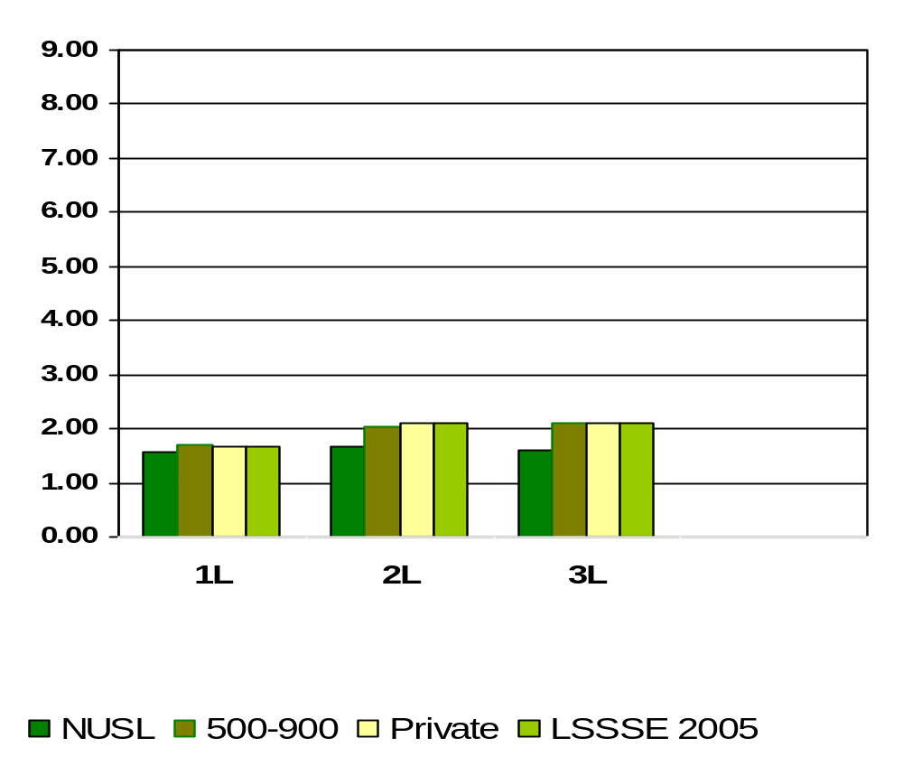
Participating in Law School-Sponsored Activities (organizations, journal, moot court, student bar association, etc.).
Means of student responses on a scale of 1 to 9 where 1=0hrs/wk and 9=More than 35 hours per week
Notes:
Comparative data for these slides is available in the Means Comparisons section. Please enter for checked items only.
To modify this slide, double-click on the slide. Then, enter the appropriate data into the Excel table. Sample data is included in the chart above.

Slide 88
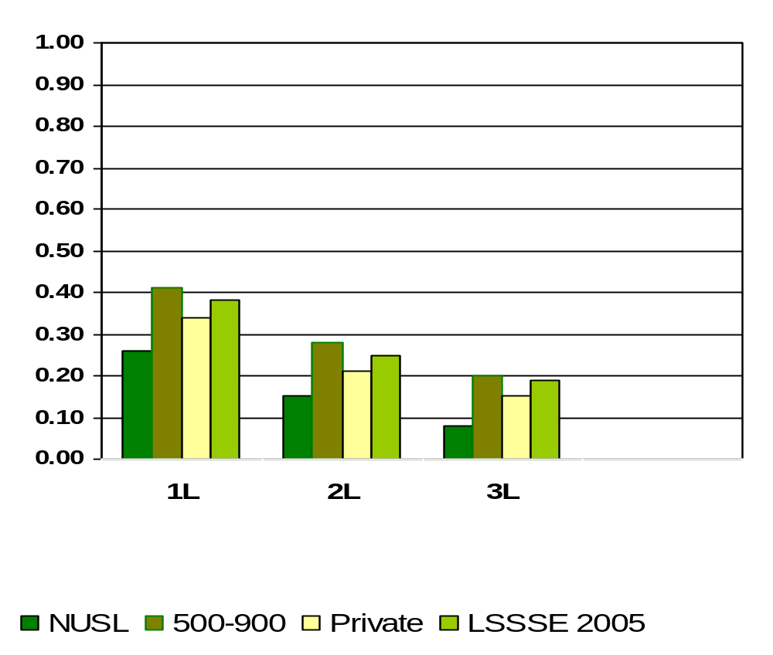
Moot Court Team
Means of student responses on a scale of 0 to 1 where 0=Undecided or do not plan to do and 1=Done or plan to do
Notes:
Comparative data for these slides is available in the Means Comparisons section. Please enter for checked items only.
To modify this slide, double-click on the slide. Then, enter the appropriate data into the Excel table. Sample data is included in the chart above.

Slide 89
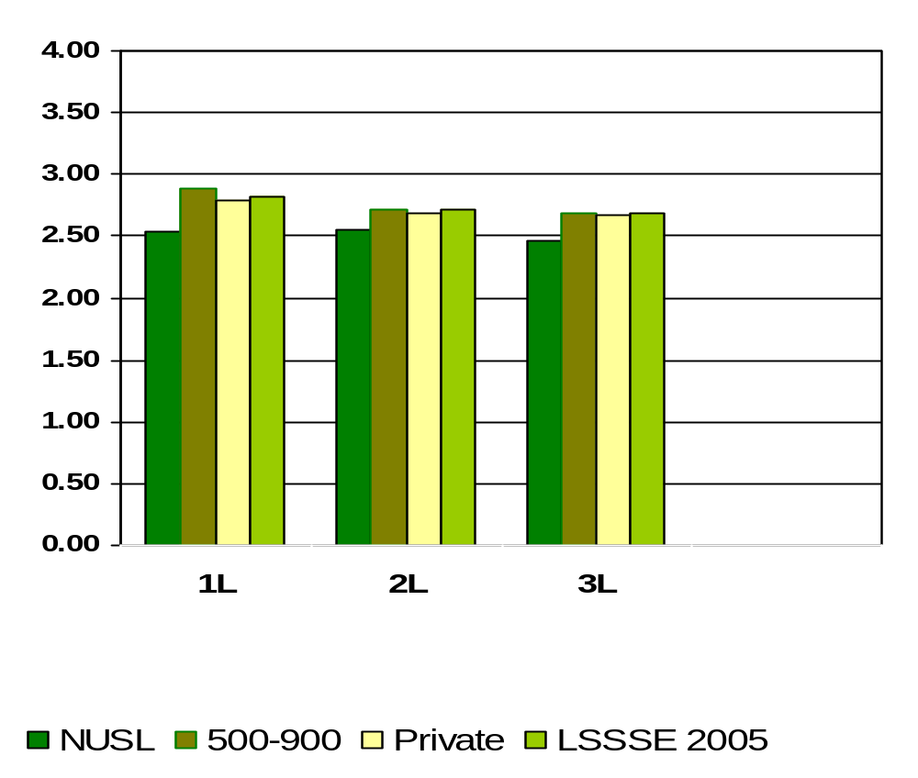
How Much Does Law School Emphasize Attending Campus Events and Activities (special speakers, cultural events, symposia, etc.)
Means of student responses on a scale of 1 to 4 where 1=Very Little and 4=Very Much
Notes:
Comparative data for these slides is available in the Means Comparisons section. Please enter for checked items only.
To modify this slide, double-click on the slide. Then, enter the appropriate data into the Excel table. Sample data is included in the chart above.

Slide 90
What percent of NUSL students felt the law school environment provides the financial aid counseling they need to afford their education?
1L
87%
2L
81%
3L
83%
Percentages measure students who believe “Some”, “Quite a bit” or “Very much” versus “Very Little”
Notes:
This section utilizes data from your Law School Report 2005. Using this template, you can create additional slides that address areas of interest for your audience. Insert your law school name and data from your school’s Frequency Distribution Report .

Slide 91
What percent of NUSL students use computers in academic work?
1L
93%
2L
85%
3L
89%
Percentages measure students who believe “Some”, “Quite a bit” or “Very much” versus “Very Little”
Notes:
This section utilizes data from your Law School Report 2005. Using this template, you can create additional slides that address areas of interest for your audience. Insert your law school name and data from your school’s Frequency Distribution Report .

Slide 92
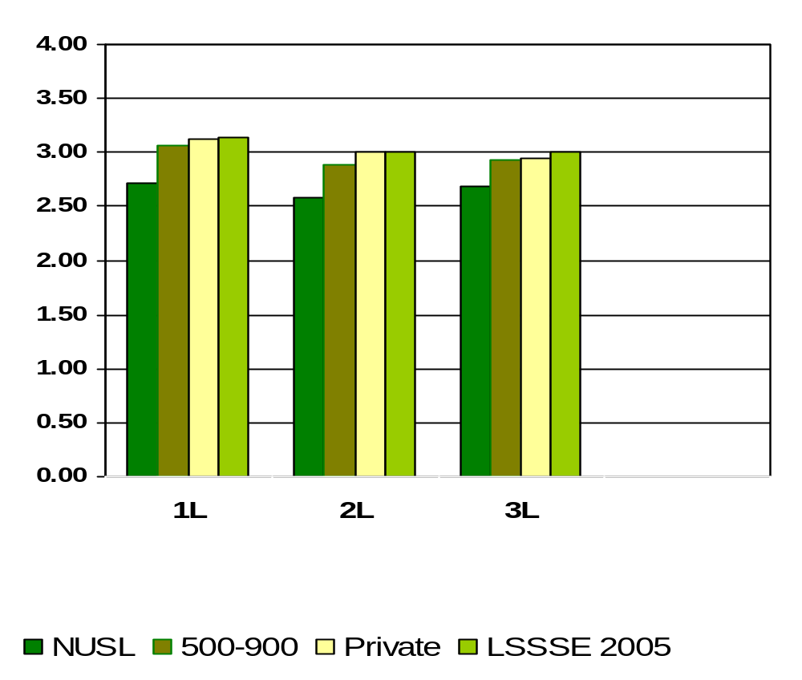
How Much Does Law School Emphasize Using Computers in Academic Work
Means of student responses on a scale of 1 to 4 where 1=Very Little and 4=Very Much
Notes:
Comparative data for these slides is available in the Means Comparisons section. Please enter for checked items only.
To modify this slide, double-click on the slide. Then, enter the appropriate data into the Excel table. Sample data is included in the chart above.

Slide 93
The quality of relationships with other students at NUSL tends toward friendly, supportive, sense of belonging.
1L
79%
2L
80%
3L
79%
Percentages measure students who lean toward a “friendly, supportive, sense of belonging” relationships versus “unfriendly, unsupportive, sense of alienation” relationships
Notes:
This section utilizes data from your Law School Report 2005. Using this template, you can create additional slides that address areas of interest for your audience. Insert your law school name and data from your school’s Frequency Distribution Report .

Slide 94
The quality of relationships with faculty at NUSL tends towards available, helpful and sympathetic.
1L
74%
2L
73%
3L
78%
Percentages measure students who lean toward a “Available, helpful, sympathetic” relationship versus “unfriendly, unsupportive, sense of alienation” relationship
Notes:
This section utilizes data from your Law School Report 2005. Using this template, you can create additional slides that address areas of interest for your audience. Insert your law school name and data from your school’s Frequency Distribution Report .

Slide 95
The quality of relationships with Administrative Staff and Offices at NUSL tends towards helpful, considerate, flexible.
1L
69%
2L
60%
3L
54%
Percentages measure students who lean toward a “Helpful, considerate, flexible” relationship versus “unhelpful, inconsiderate, rigid” relationship
Notes:
This section utilizes data from your Law School Report 2005. Using this template, you can create additional slides that address areas of interest for your audience. Insert your law school name and data from your school’s Frequency Distribution Report .

Slide 96
What percentage of NUSL students believe the law school contributed significantly to acquiring a broad legal education?
1L
90%
2L
87%
3L
86%
Percentages measure students who believe “Quite a bit” or “Very much” versus “Some” or “Very Little”
Notes:
This section utilizes data from your Law School Report 2005. Using this template, you can create additional slides that address areas of interest for your audience. Insert your law school name and data from your school’s Frequency Distribution Report .

Slide 97
What percentage of NUSL students believe the law school contributed significantly to acquiring job or work-related knowledge and skills?
1L
79%
2L
85%
3L
87%
Percentages measure students who believe “Quite a bit” or “Very much” versus “Some” or “Very Little”
Notes:
This section utilizes data from your Law School Report 2005. Using this template, you can create additional slides that address areas of interest for your audience. Insert your law school name and data from your school’s Frequency Distribution Report .

Slide 98
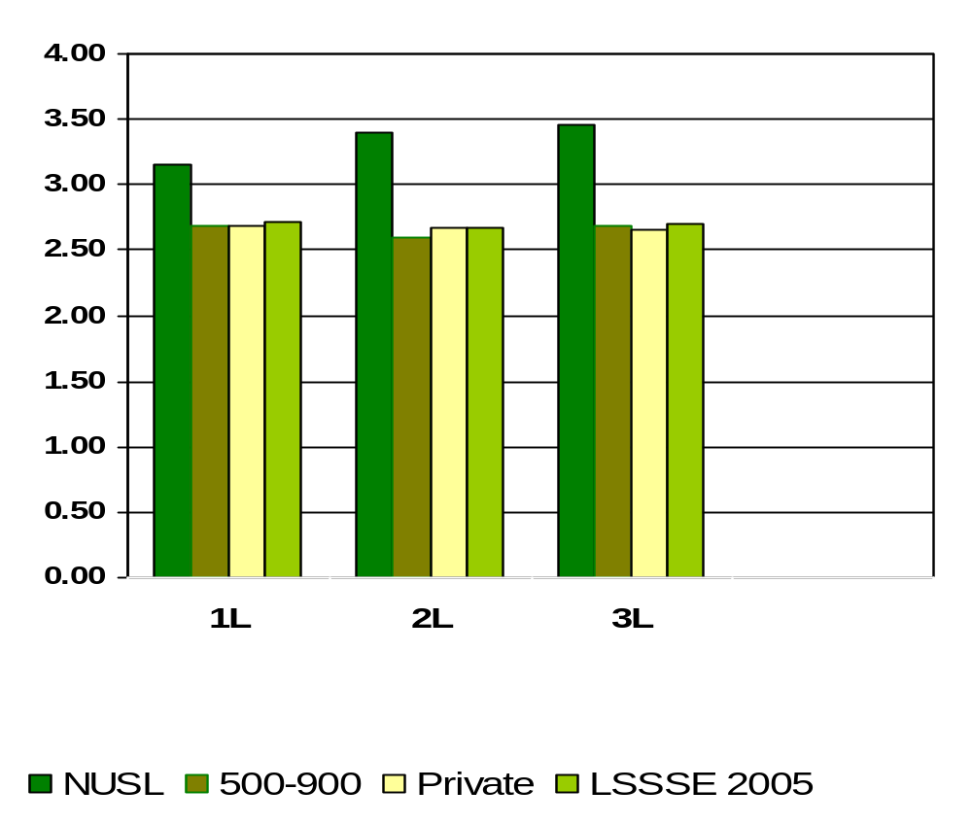
How Much Law School Experience Contributed to Acquiring Job or Work-Related Knowledge and Skills
Means of student responses on a scale of 1 to 4 where 1=Very Little and 4=Very Much
Notes:
Comparative data for these slides is available in the Means Comparisons section. Please enter for checked items only.
To modify this slide, double-click on the slide. Then, enter the appropriate data into the Excel table. Sample data is included in the chart above.

Slide 99
What percentage of NUSL students believe the law school contributed significantly to writing clearly and effectively?
1L
76%
2L
62%
3L
78%
Percentages measure students who believe “Quite a bit” or “Very much” versus “Some” or “Very Little”
Notes:
This section utilizes data from your Law School Report 2005. Using this template, you can create additional slides that address areas of interest for your audience. Insert your law school name and data from your school’s Frequency Distribution Report .

Slide 100
What percentage of NUSL students believe the law school contributed significantly to speaking clearly and effectively?
1L
66%
2L
49%
3L
66%
Percentages measure students who believe “Quite a bit” or “Very much” versus “Some” or “Very Little”
Notes:
This section utilizes data from your Law School Report 2005. Using this template, you can create additional slides that address areas of interest for your audience. Insert your law school name and data from your school’s Frequency Distribution Report .

Slide 101
What percentage of NUSL students believe the law school contributed significantly to thinking critically and analytically?
1L
92%
2L
83%
3L
87%
Percentages measure students who believe “Quite a bit” or “Very much” versus “Some” or “Very Little”
Notes:
This section utilizes data from your Law School Report 2005. Using this template, you can create additional slides that address areas of interest for your audience. Insert your law school name and data from your school’s Frequency Distribution Report .

Slide 102
What percentage of NUSL students believe the law school contributed significantly to developing legal research skills?
1L
73%
2L
70%
3L
74%
Percentages measure students who believe “Quite a bit” or “Very much” versus “Some” or “Very Little”
Notes:
This section utilizes data from your Law School Report 2005. Using this template, you can create additional slides that address areas of interest for your audience. Insert your law school name and data from your school’s Frequency Distribution Report .

Slide 103
What percentage of NUSL students believe the law school contributed significantly to working effectively with others?
1L
81%
2L
64%
3L
68%
Percentages measure students who believe “Quite a bit” or “Very much” versus “Some” or “Very Little”
Notes:
This section utilizes data from your Law School Report 2005. Using this template, you can create additional slides that address areas of interest for your audience. Insert your law school name and data from your school’s Frequency Distribution Report .

Slide 104
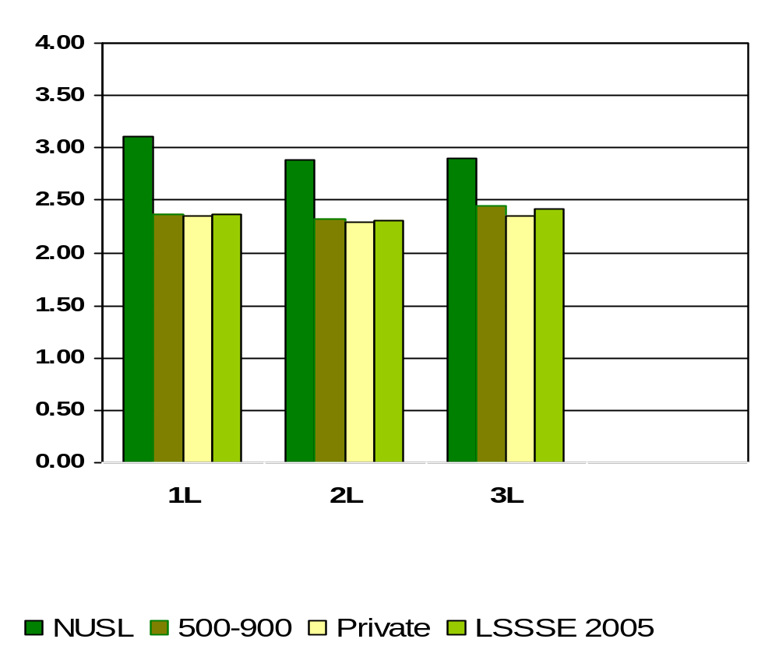
How Much Law School Experience Contributed to Working Effectively with Others
Means of student responses on a scale of 1 to 4 where 1=Very Little and 4=Very Much
Notes:
Comparative data for these slides is available in the Means Comparisons section. Please enter for checked items only.
To modify this slide, double-click on the slide. Then, enter the appropriate data into the Excel table. Sample data is included in the chart above.

Slide 105
What percentage of NUSL students believe the law school contributed significantly to learning effectively on their own?
1L
79%
2L
79%
3L
86%
Percentages measure students who believe “Quite a bit” or “Very much” versus “Some” or “Very Little”
Notes:
This section utilizes data from your Law School Report 2005. Using this template, you can create additional slides that address areas of interest for your audience. Insert your law school name and data from your school’s Frequency Distribution Report .

Slide 106
What percentage of NUSL students believe the law school contributed significantly to understanding themselves?
1L
54%
2L
58%
3L
63%
Percentages measure students who believe “Quite a bit” or “Very much” versus “Some” or “Very Little”
Notes:
This section utilizes data from your Law School Report 2005. Using this template, you can create additional slides that address areas of interest for your audience. Insert your law school name and data from your school’s Frequency Distribution Report .

Slide 107
What percentage of NUSL students believe the law school contributed significantly to solving complex real-world problems?
1L
63%
2L
60%
3L
64%
Percentages measure students who believe “Quite a bit” or “Very much” versus “Some” or “Very Little”
Notes:
This section utilizes data from your Law School Report 2005. Using this template, you can create additional slides that address areas of interest for your audience. Insert your law school name and data from your school’s Frequency Distribution Report .

Slide 108
What percentage of NUSL students believe the law school contributed significantly to developing clearer career goals?
1L
54%
2L
54%
3L
48%
Percentages measure students who believe “Quite a bit” or “Very much” versus “Some” or “Very Little”
Notes:
This section utilizes data from your Law School Report 2005. Using this template, you can create additional slides that address areas of interest for your audience. Insert your law school name and data from your school’s Frequency Distribution Report .

Slide 109
What percentage of NUSL students believe the law school contributed significantly to developing a personal code of values and ethics?
1L
48%
2L
49%
3L
49%
Percentages measure students who believe “Quite a bit” or “Very much” versus “Some” or “Very Little”
Notes:
This section utilizes data from your Law School Report 2005. Using this template, you can create additional slides that address areas of interest for your audience. Insert your law school name and data from your school’s Frequency Distribution Report .

Slide 110
What percentage of NUSL students believe the law school contributed significantly to them contributing to the welfare of their community?
1L
58%
2L
54%
3L
59%
Percentages measure students who believe “Quite a bit” or “Very much” versus “Some” or “Very Little”
Notes:
This section utilizes data from your Law School Report 2005. Using this template, you can create additional slides that address areas of interest for your audience. Insert your law school name and data from your school’s Frequency Distribution Report .

Slide 111
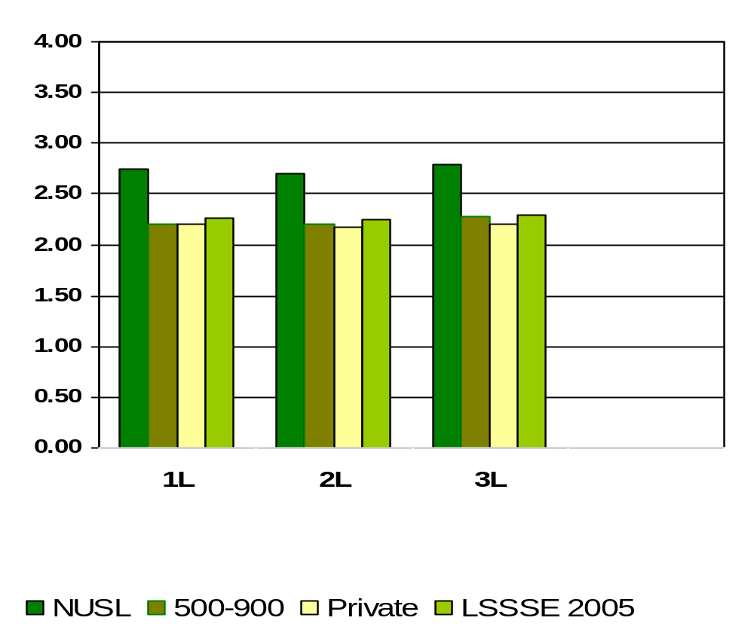
How Much Law School Experience Contributed to Contributing to the Welfare of Your Community
Means of student responses on a scale of 1 to 4 where 1=Very Little and 4=Very Much
Notes:
Comparative data for these slides is available in the Means Comparisons section. Please enter for checked items only.
To modify this slide, double-click on the slide. Then, enter the appropriate data into the Excel table. Sample data is included in the chart above.

Slide 112
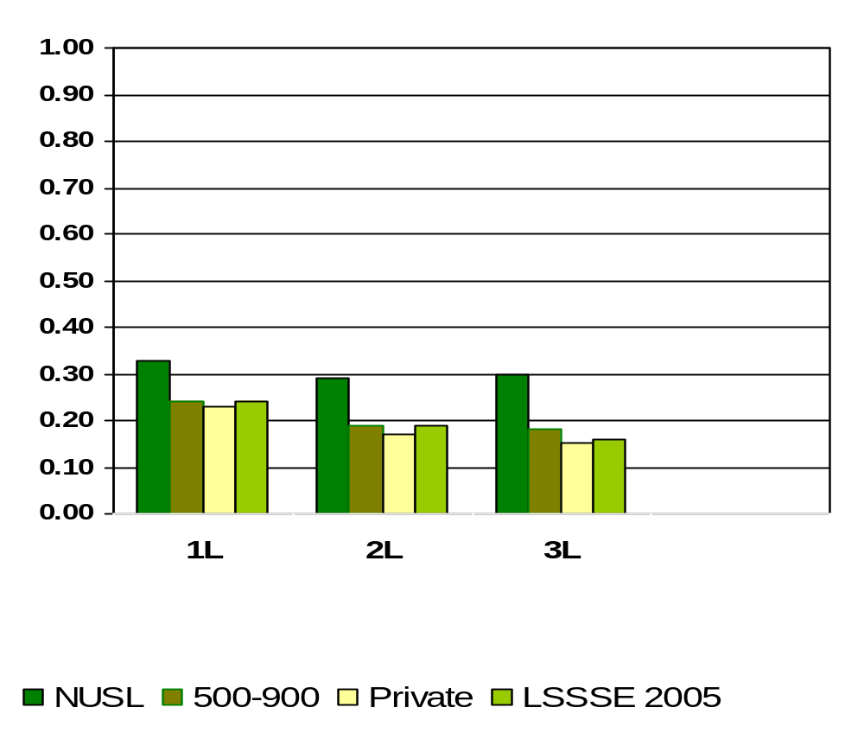
Expectation of Service on a Student-Faculty Committee
Means of student responses on a scale of 0 to 1 where 0=Undecided or do not plan to do and 1=Done or plan to do
Notes:
Comparative data for these slides is available in the Means Comparisons section. Please enter for checked items only.
To modify this slide, double-click on the slide. Then, enter the appropriate data into the Excel table. Sample data is included in the chart above.

Slide 113
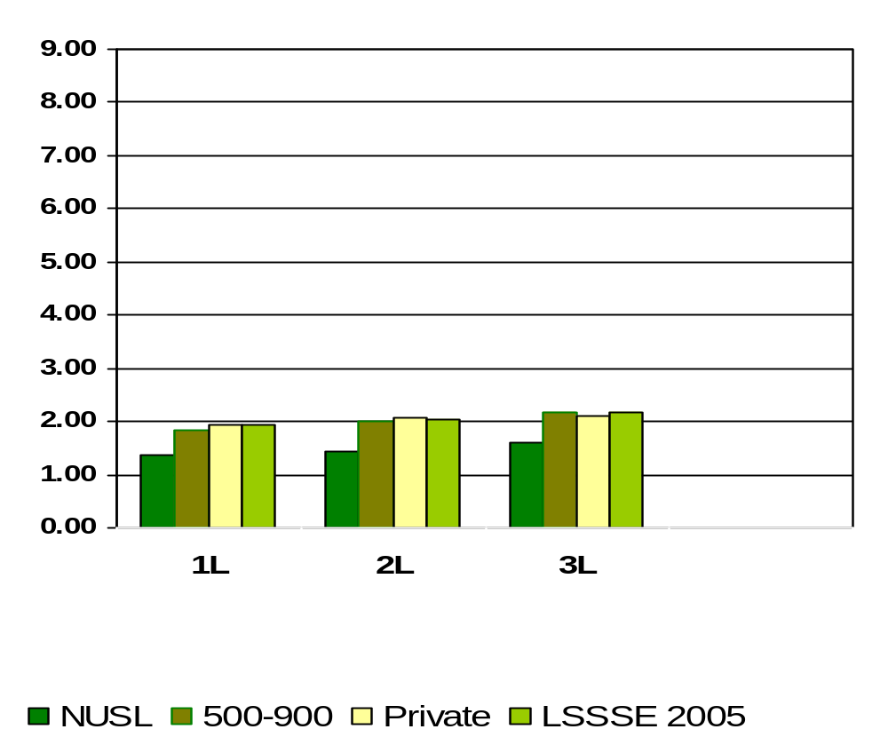
Providing Care for Dependants Living with You (parents, children, spouses, etc.)
Means of student responses on a scale of 1 to 9 where 1=0hrs/wk and 9=More than 35 hours per week
Notes:
Comparative data for these slides is available in the Means Comparisons section. Please enter for checked items only.
To modify this slide, double-click on the slide. Then, enter the appropriate data into the Excel table. Sample data is included in the chart above.

Slide 114
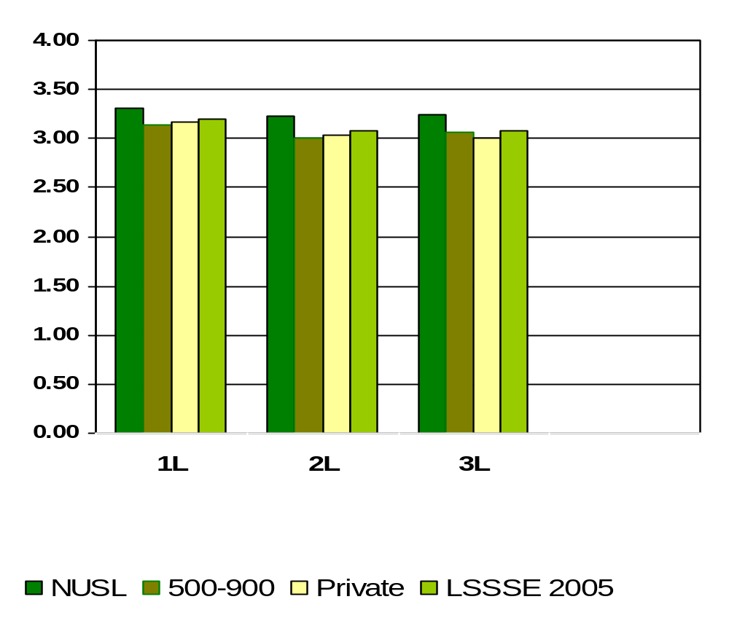
How Would You Evaluate Your Entire Educational Experience at Your Law School?
Means of student responses on a scale of 1 to 4 where 1=Poor and 4=Excellent
Notes:
Comparative data for these slides is available in the Means Comparisons section. Please enter for checked items only.
To modify this slide, double-click on the slide. Then, enter the appropriate data into the Excel table. Sample data is included in the chart above.

Slide 115
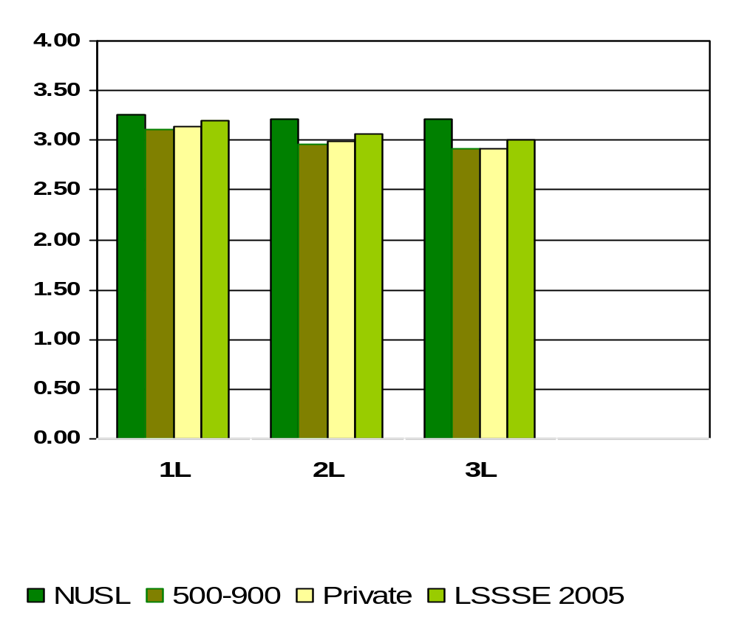
If You Could Start Over Again, Would You Go to the Same Law School You Are Now Attending?
Means of student responses on a scale of 1 to 4 where 1=Definitely No and 4=Definitely Yes
Notes:
Comparative data for these slides is available in the Means Comparisons section. Please enter for checked items only.
To modify this slide, double-click on the slide. Then, enter the appropriate data into the Excel table. Sample data is included in the chart above.

Slide 116
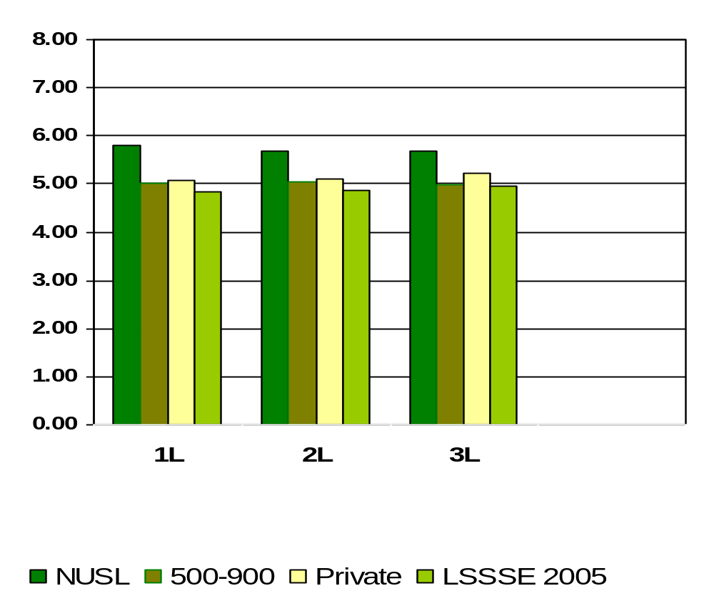
How Much Educational Debt From Attending Law School Do You Expect to Have Upon Your Graduation?
Means of student responses on a scale of 1 to 8 where 1=$0, 2=$1-$20,000, 3=$20,001-$40,000, 4=$40,001-$60,000, 5=60,001-$80,000, 6=$80,001-$100,000, 7=$100,001-$120,000 and 8=More than $120,000
Notes:
Comparative data for these slides is available in the Means Comparisons section. Please enter for checked items only.
To modify this slide, double-click on the slide. Then, enter the appropriate data into the Excel table. Sample data is included in the chart above.

